Slide 1
welcome!

Slide 2
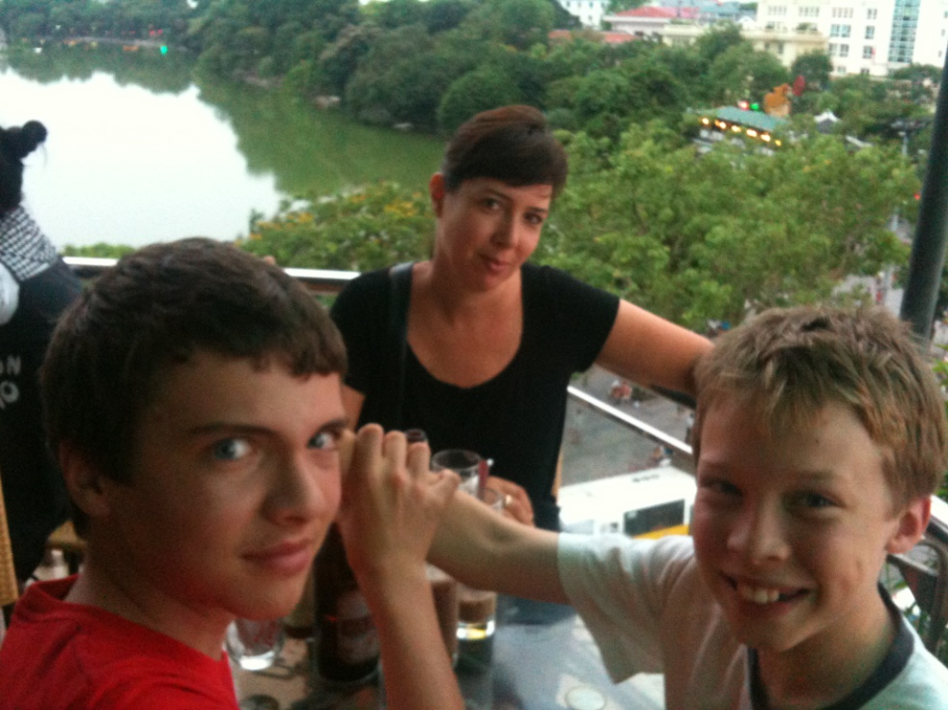
Who am I?

Slide 3
Clergy = teacher?
Your ministry as an educator

Slide 4
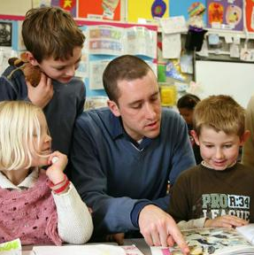
Our experience of teachers

Slide 5
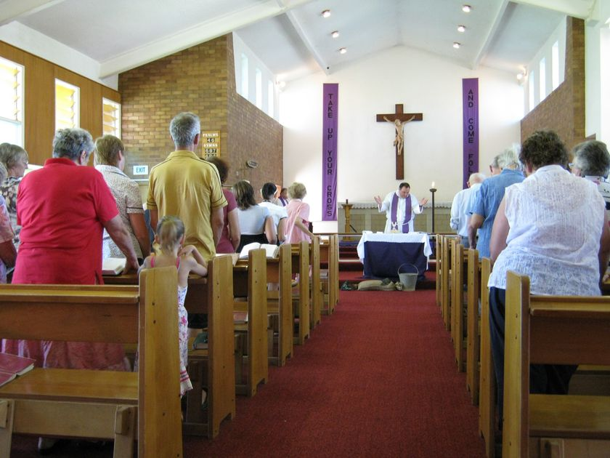
In what ways are you / will you be a teacher?
Where do you do teaching?
When
To whom?
Notes:
It’s in your ordination vows, so….

Slide 6
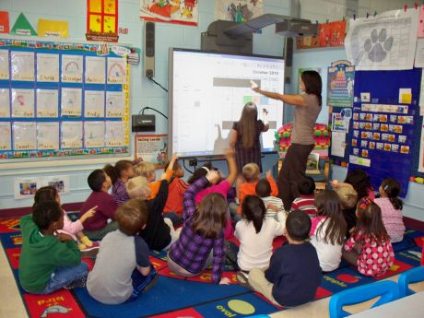
What is a teacher?
a planner
an assessor
moves people from a to b
mentor
a role model
wants to engage, inspire and empower
agent of change
looks for the teachable moment
someone who cares about people enough to want to do these things
resource manager
seeks to understand their charges

Slide 7
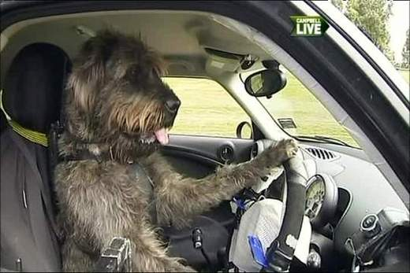
You need to teach someone to do something. How would you do it?
Notes:
Think of your hobby… how could tyou teach someone to do that thing?
Eg how to set up apple tv
Or how to cook steak on a BBQ or

Slide 8
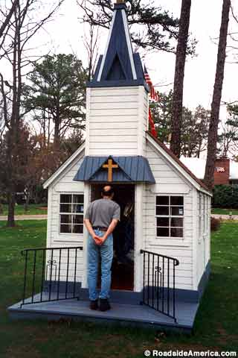
Context!
Does it depend on what the thing (content) is?
Does it depend on who your students you are?
Does it depend on what resources you’ll have access to?
Does it depend on where you’ll be teaching?

Slide 9
So what is your curriculum?

Slide 10
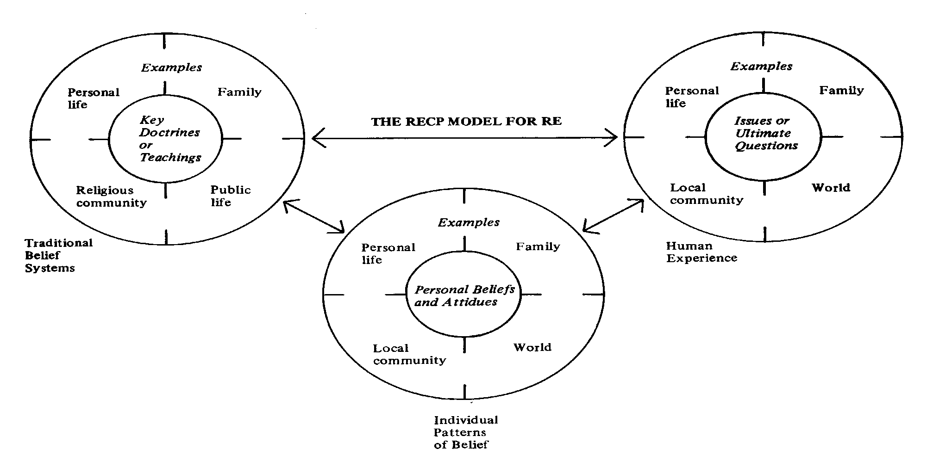
A Teaching Model for Religious Education
Notes:
7. A TEACHING MODEL FOR RELIGIOUS EDUCATION
Purpose: To provide participants with an understanding of the ‘3 circle model’ of RE teaching.
Time: 30 minutes
(A) UNDERSTANDING THE TEACHING MODEL
Explain to participants that it is important to:
- develop an effective working model for RE teaching, whether a denominational or co-operative model is selected for the school site.
- understand a model that recognises different and important facets of an RE lesson.
This model may be applied to any religious group or community.
(B) EXPLORE THE TEACHING MODEL IN SMALL GROUPS
Break into small groups and use magazines, newspapers, words and symbols to make a collage of topics, issues, learnings that should be included in an RE program (allow 8 - 10 minutes).
Invite a spokesperson to report back to the whole group.
EITHER:
As feedback is given, collate/record key statements in 1 of the 3 circles on this OHT
OR:
Blue-Tac the headings (Tradition and Beliefs/Human Experience/Individual Experience -- Appendix 4A/B) on text or pictures on the posters presented.

Slide 11
Key Doctrines or Teachings
traditional
beliefs
and teachings
FEATURES
scriptures/sacred writings
creeds
stories
music
rites
symbols
distinctive language
gestures
organisational structure
Notes:
(C) FURTHER EXPLORATION
To further explain the model, participants may find it helpful to explore the key features of each circle. The features listed assist in identifying characteristics of that circle. Some words and phrases listed may not be familiar or apply to some participants and sensitivity needs to be exercised.
Participants may like to share what are some significant features of their tradition. These could be added to those listed on the OHT or on a suitably titled poster on the wall.

Slide 12
Human Experiences
issues
and
ultimate
questions
FEATURES
why do we experience joy and suffering?
who are we?
how should we live together?
what is the meaning of life?
to whom are we accountable?
how should we relate to the natural world?
Notes:
(D) ULTIMATE QUESTIONS
Participants may like to contribute what they consider to be ultimate questions. Record on the OHT slide or on butcher’s paper with the appropriate heading.

Slide 13
Individual Patterns of Belief
personal
beliefs
and
spirituality
FEATURES
‘I believe there is a God who cares’
‘I have experienced God’s forgiveness’
‘I believe ...’
‘I am a worthwhile person’
‘I grow through ...’
‘I care ...’
Notes:
(E) PERSONAL BELIEFS
Participants may like to share their personal beliefs. Record on the OHT slide or on butcher’s paper with the appropriate heading.

Slide 14
The people you are teaching…

Slide 15
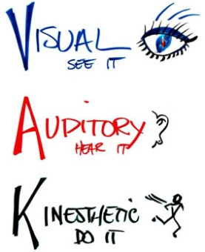
Learning preferences
Notes:
(A) LEARNING STYLES
Set up 3 learning centres and invite participants to divide into the 3 groups.
Use the worksheets (Appendices 2, 3 & 4) to explore the different ways in which people learn and the implications for teaching. Ask participants to spend a few minutes in each group area responding to the questions on the work-sheets.
NB: To create a puzzle for use with the Kinaesthetic Learners worksheet (Appendix 4), cut up a colourful scene (e.g. from a calendar or large magazine picture) and mount on cardboard. Cut into irregular jigsaw shapes.
Invite participants to identify their own particular learning style by using Handout 3, What is my learning style?
(B) WHAT DO I NEED TO REMEMBER WHEN I TEACH?
In the large group discuss the implications for teaching a class of children. How do we ensure that we cater for each of the learning styles?
NB: Point out that whilst people must have a preferred style of teaching, it is important to remember that they need to consider the different learning styles of the students they teach.
Resource Box
(1) Invite participants to think of particular students they teach:
which students particularly enjoy the use of visuals?
which students particularly seem to enjoy listening activities?
which students particularly enjoy doing?
(2) Using Appendix 5, cut into cards, distribute and ask participants to sort into groups: auditory, visual, tactile.

Slide 16
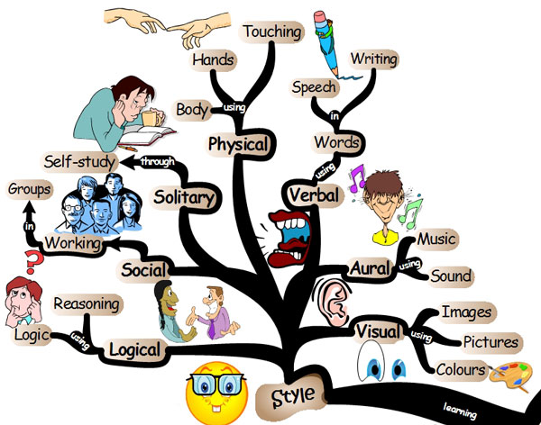

Slide 17
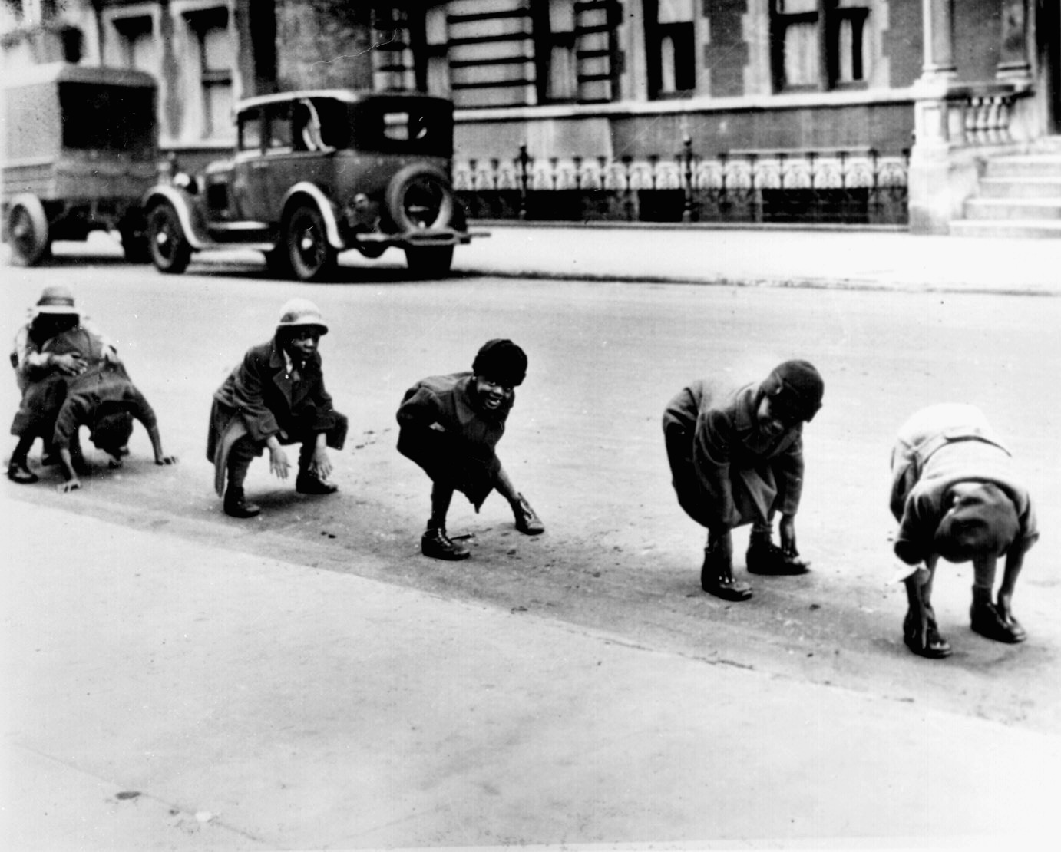
The Shifts

Slide 18
Television Rejected
‘It is unidirectional, with the choice of programming and content resting in the hands of the few, and it’s product dumbed down to the lowest common denominator..’
Notes:
‘It is unidirectional, with the choice of programming and content resting in the hands of the few, and it’s product dumbed down to the lowest common denominator…’
Share the idea that the methodology of television has changed in nature since its invention, and that such change is even more necessary today because of the demands of young people and children. More interactivity is called for, as is more choice.

Slide 19
Internet Embraced
‘To digital savvy ‘n-geners’ television should be interactive. It should do what the consumer asks. It should enable a dialogue and allow for citizens to speak with one another. This shift from broadcast to interactive is the cornerstone of the N-Generation. They want to be users - not just viewers or listeners.’
Notes:
‘To digital savvy ‘n-geners’ television should be interactive. It should do what the consumer asks. It should enable a dialogue and allow for citizens to speak with one another. This shift from broadcast to interactive is the cornerstone of the N-Generation. They want to be users - not just viewers or listeners.’
Share the idea that these demands as mentioned on the previous page have been brought about, or at least are being fuelled by the nature of the Internet, which has exponentially increasing choice, and a feeling of real interactivity.
In this sense they are anything but the passive generation painted by some. They crave a sense of control over some aspect of their lives, and this is offered by the opportunities available through the Internet.

Slide 20
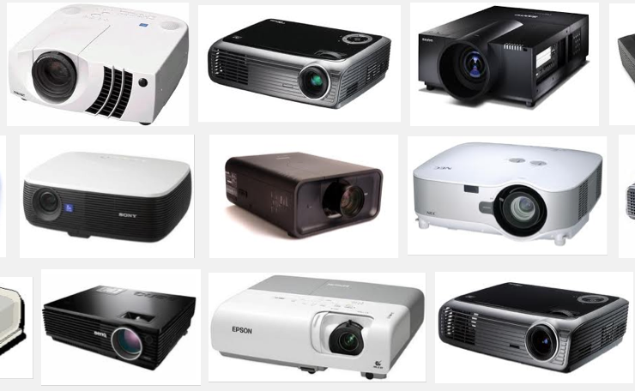
With what, and where…
Resources and location
Ultimately it’s the learners’ needs that should determine every choice…

