Slide 1
www.formedfaith.org
The home of

Slide 2
New Skills in Teaching Faith

Slide 3
ACKNOWLEDGEMENT OF COUNTRY
We acknowledge the Traditional Custodians of the land on which we meet and their elders past, present and future
Notes:
Please Acknowledge Country (with names of local Aboriginal people(s) if known). Try to find this information out in preparation for this day of learning.
Here’s an example by Jonathan Hill
Today we stand in footsteps millennia old.
May we acknowledge the traditional custodians whose cultures and customs have nurtured, and continue to nurture, this land, since men and women awoke from the great dream.
We honour the presence of these ancestors who reside in the imagination of this land and whose irrepressible spirituality flows through all creation.
Jonathan Hill is an Aboriginal poet living in New South Wales.
Original source: 'Acknowledgement of Country', reader's letter, Koori Mail 469 p.23 Source: http://www.creativespirits.info/aboriginalculture/spirituality/welcome-to-country-acknowledgement-of-country#ixzz44uaMAxjy

Slide 4
Jonathan Sargeant Director of Lay Education
Notes:
Who am I? And from where do I come?

Slide 5
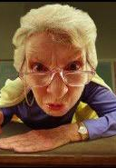
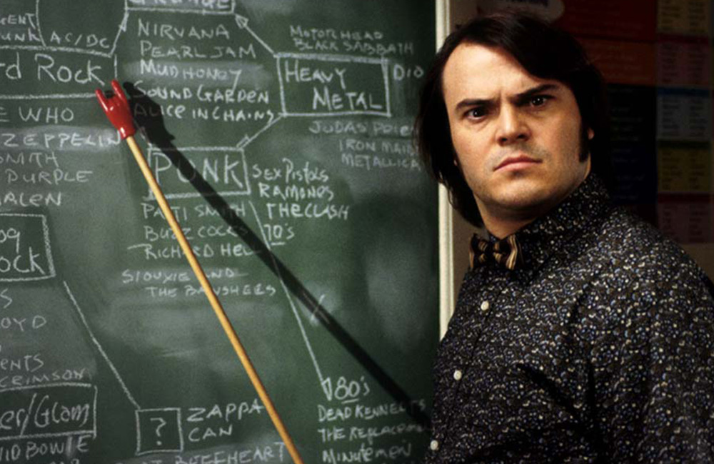
Our experience of teachers
A memorable teacher and one thing they did…

Slide 6
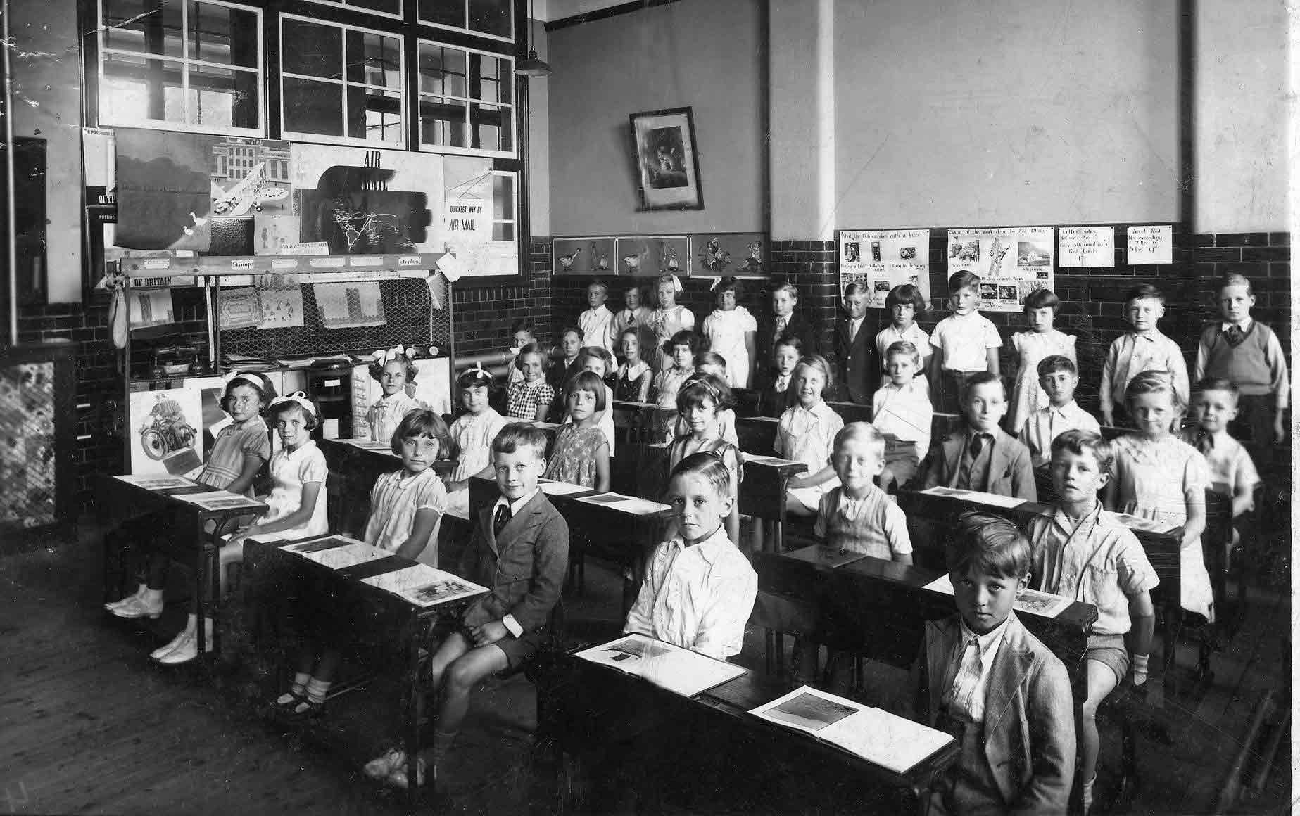
Traditional Classroom?
Begins with parts of the whole–Emphasizes basic skills
Strict adherence to fixed curriculum
Textbooks and workbooks
Instructor gives/students receive
Instructor assumes directive, authoritative role
Assessment via testing / correct answers
Knowledge is inert
Students work individually
Notes:
The Traditional Classroom – what does it look like?
Sometimes similar today, especially in soe secondary schools
Begins with parts of the whole–Emphasizes basic skills
Strict adherence to fixed curriculum
Textbooks and workbooks
Instructor gives/students receive
Instructor assumes directive, authoritative role
Assessment via testing / correct answers
Knowledge is inert
Students work individually
The constructivist Classroom
Begin with the whole – expanding to parts
Pursuit of student questions / interests
Primary Sources / manipulative materials
Learning is interaction – building on what students already know
Instructor interacts / negotiates with students
Assessment via student works, observations, points of view, tests. Process is as important as product
Knowledge is dynamic / change with experiences
Students work in groups

Slide 7
Constructivist
Notes:
Piaget!! Swiss psychologist and educator – theory of cognitive development! That led to the constructivist theory of knowing, widely popularised in the 60s

Slide 8
Constructivist
A more modern classroom?
Begin with the whole – expanding to parts
Pursuit of student questions / interests
Primary Sources / manipulative materials
Learning is interaction – building on what students already know
Instructor interacts / negotiates with students
Assessment via student works, observations, points of view, tests. Process is as important as product
Knowledge is dynamic / change with experiences
Students work in groups
Notes:
A more modern classroom, especially for younger children?

Slide 9
Notes:
Blooms taxonomy of thinking, simplest to most complex,
OR
Head upwards to deepest learning/knowing

Slide 12
Introducing the Learning Focus
Skill 1: Identifying what the learner already knows
Notes:
Note the idea of Ordinary Theology and Jeff Astley as one way of taking this skill seriously

Slide 13
The Mind Map Book – Tony Buzan 1996

Slide 14
https://www.youtube.com/watch?v=u5Y4pIsXTV0

Slide 15
The Mind Map Book – Tony Buzan 1996

Slide 16
The Mind Map Book – Tony Buzan 1996

Slide 17
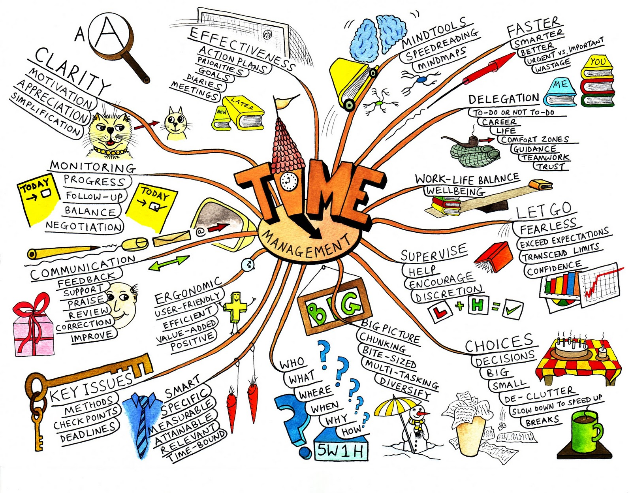
Mind Map Laws
Techniques
Use emphasis
Use association
Be clear
Develop a personal style
Layout
Use hierarchy
Use numerical order
The Mind Map Book – Tony Buzan 1996

Slide 18
The Mind Map Book – Tony Buzan 1996
Notes:
So let’s create one, in groups of ____ with this topic –What do people already know About the Bible?
What are big areas to know? OT, NT, GENRE, HOW TO READ IT, CANON DEVELOPMENT
Then brainstorm under each big area…

Slide 19
K.W.H.L
What do I KNOW | What do I WANT to know
HOW will I find out | What have I LEARNT

Slide 20
https://www.youtube.com/watch?v=T0MKzxAc1d8

Slide 21
looks like
sounds like
feels like
Notes:
Explain Y Chart

Slide 22
https://www.youtube.com/watch?v=qr_VwlOalfw
Notes:
Now ret

Slide 23
looks like
sounds like
feels like
Notes:
Now have a go at this in groups of ____.
The topic is The Church

Slide 24
Introducing the Learning Focus
Skill 2: Stimulate interest when introducing a topic

Slide 25
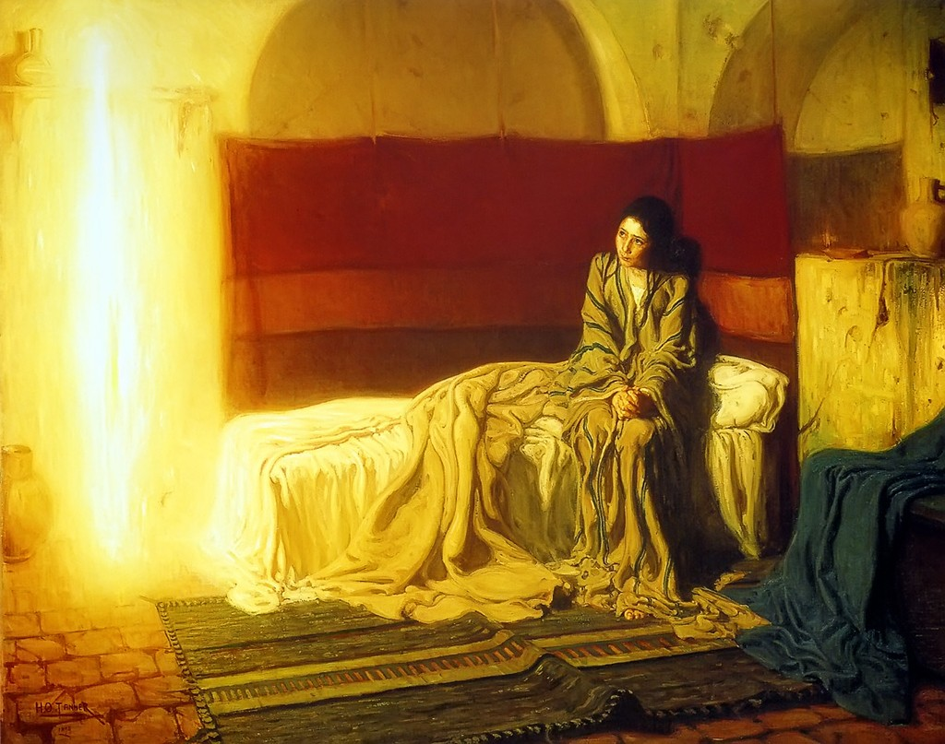
Notes:
The Annunciation by African-American artist Henry Ossawa Tanner (1857-1939), painted in1898.
http://studiomatters.com/a-domestic-annunciation

Slide 26
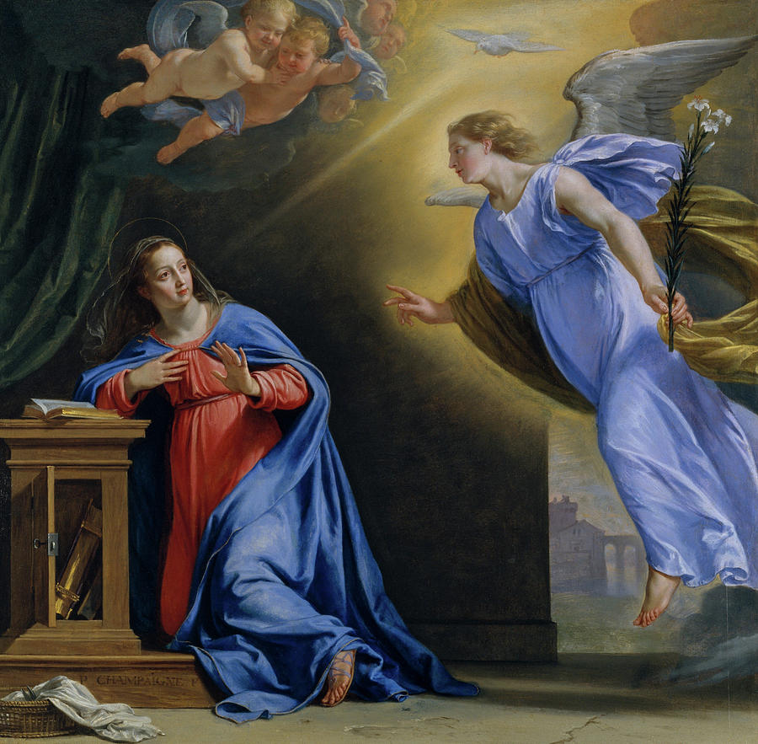
Notes:
Artist: Philippe de Champaigne (French, Brussels 1602–1674 Paris) Date: ca. 1644
Medium: Oil on oak

Slide 27
Methods for Collaborative Learning
Skill 3: Helping learners share their thoughts

Slide 28
Think Pair Share
Notes:
The problem? – groups that need to warm up a little
The answer Think Pair Share
What are your three favourite movies?

Slide 29
Methods for Collaborative Learning
Skill 4: Providing activities that stimulate learning

Slide 31
https://www.youtube.com/watch?v=tnMbYaRj7Pg
Notes:
Spot the Spelling mistake!

Slide 32
Methods for Collaborative Learning
Skill 5: Helping learners identify their values

Slide 33
Tournament Prioritiser
Notes:
Activity: What do you think the skills of a good teacher are?
[Tournament Prioritiser]
DO THIS ON WHITE BOARD

Slide 34
human continuum
agree
disagree
Notes:
Keeping library books overdue is okay if you have a deadline
You should never ride the tram without your Octopus card/without paying the fare
Lecturers from Australia are lunatics
Truth is more important that unity

Slide 35
Methods for Collaborative Learning
Skill 6: Providing activities for collaborative learning

Slide 36
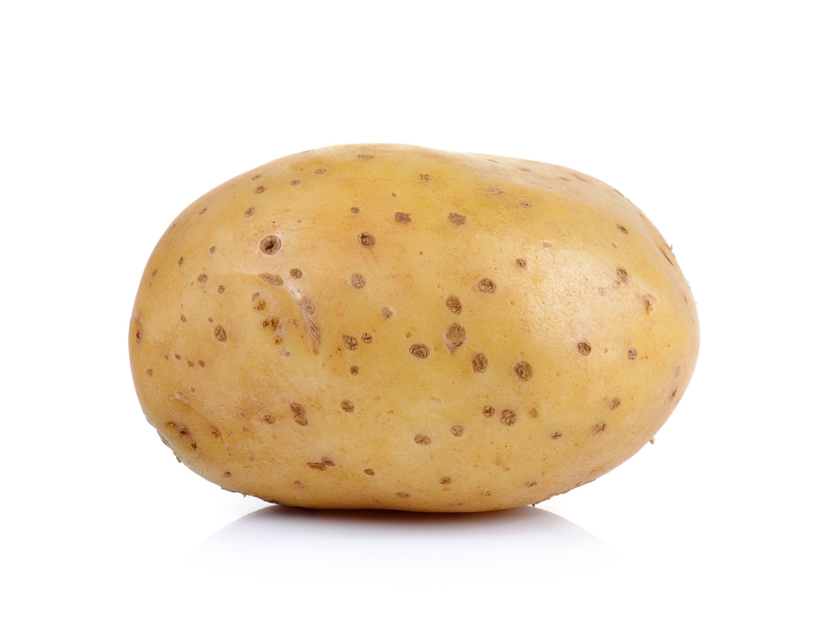
Round Robin and Hot Potato
Notes:
Round Robin – everyone works on same topic/question
Hot Potato – different topics/questions
Question per chart, on each table then rotate through…

Slide 37
Judge and Jury
Notes:
Appoint roles of judge and two to argue a case – judge decides – or have more students to be the jury
“Sunday worship should always be a eucharist”

Slide 38
Communicating
Skill 7: Communicating ideas and information clearly

Slide 39
4 ideas
from
brainslides.com

Slide 40
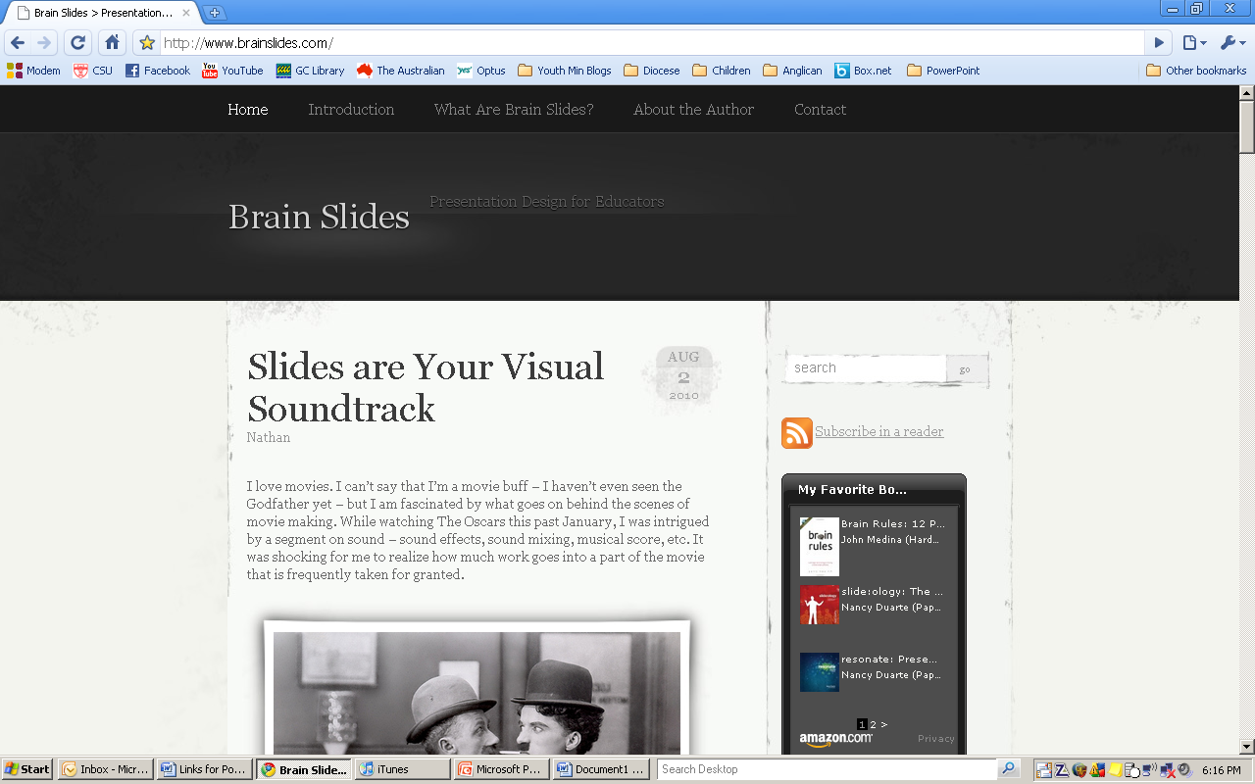

Slide 41
visual cues
Notes:
Visual Cues – Composers use musical cues to prepare the audience for what is happening on the screen – a sharp, dissonant forte from the strings when Jaws attacks from the water; a light legato during a romantic scene; or a triumphant crescendo during the climax of the movie. Your slides can be visual cues for your students to help them know what is coming next. You might show a fullscreen image of body builders before detailing actin and myosin, the molecular components of muscle fibers, for example. Or use an image of a juicy, charbroiled cheeseburger when you discuss the principle of caloric intake in your nutrition course. Also, changing the design theme is one way to signal when you are moving on to the next chapter.

Slide 42
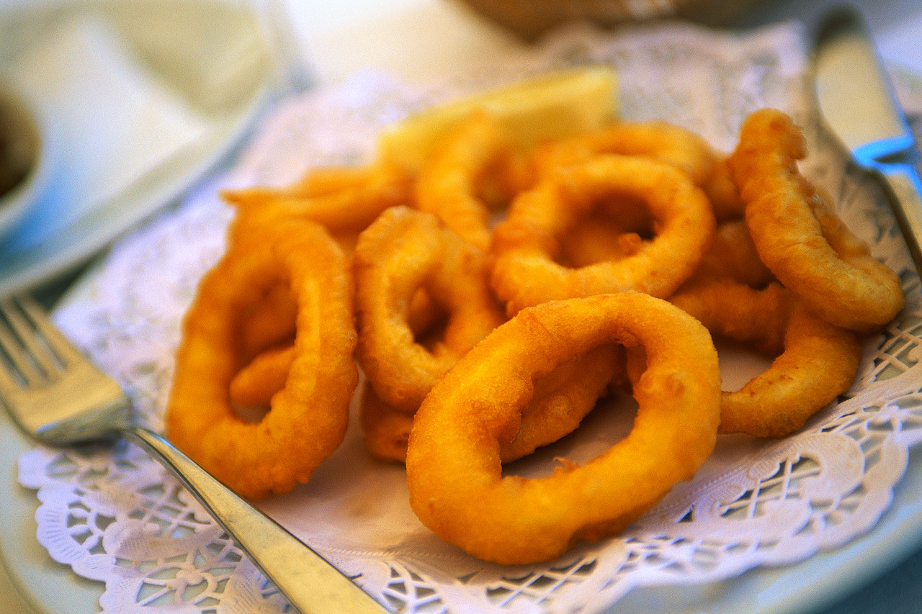
caloric intake

Slide 43
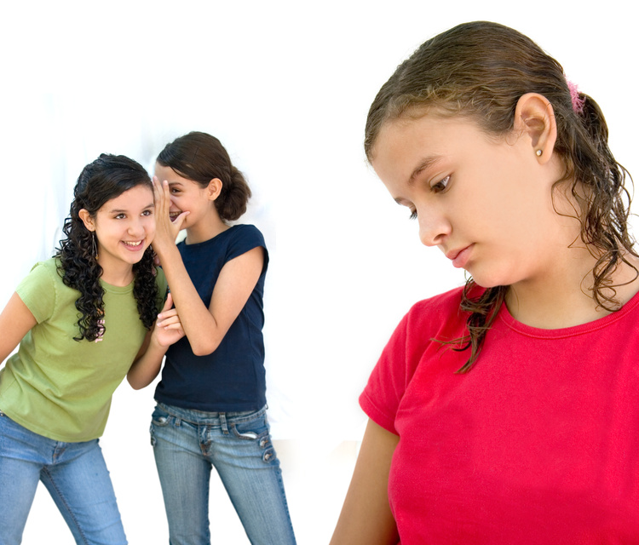
gossip

Slide 44
emotion
Notes:
Emotion – The music in a movie greatly enhances how the audience feels about the characters and story. Choosing images that evoke emotion – a crying baby or laughing teenager, for instance – can aid in your students' retention. According to Dr. Medina in Brain Rules, "Emotionally charged events persist much longer in our memories and are recalled with greater accuracy than neutral memories." This is one reason bullet points are so ineffective – nobody cares about lists! Instead of listing the masterpieces you'll discuss in Art History, begin with a clip from The DaVinci Code which introduces the paintings and the meaning behind them. Give students a reason to care!

Slide 45
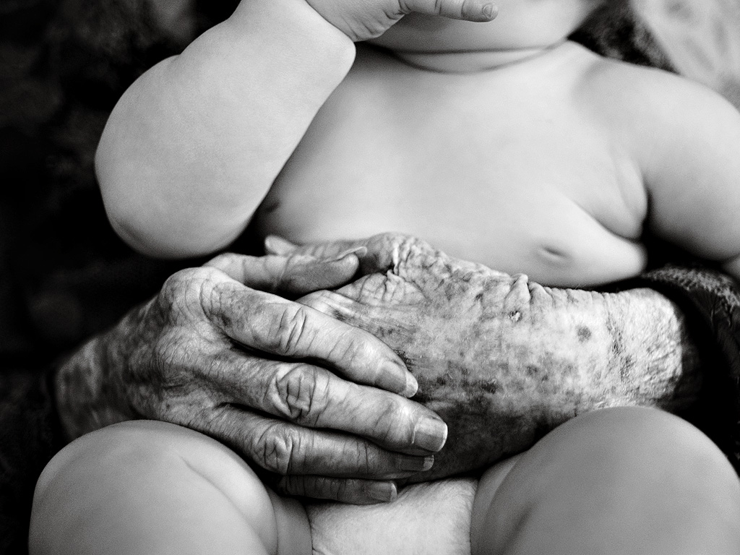
generations

Slide 47
I am
only
eight!

Slide 48
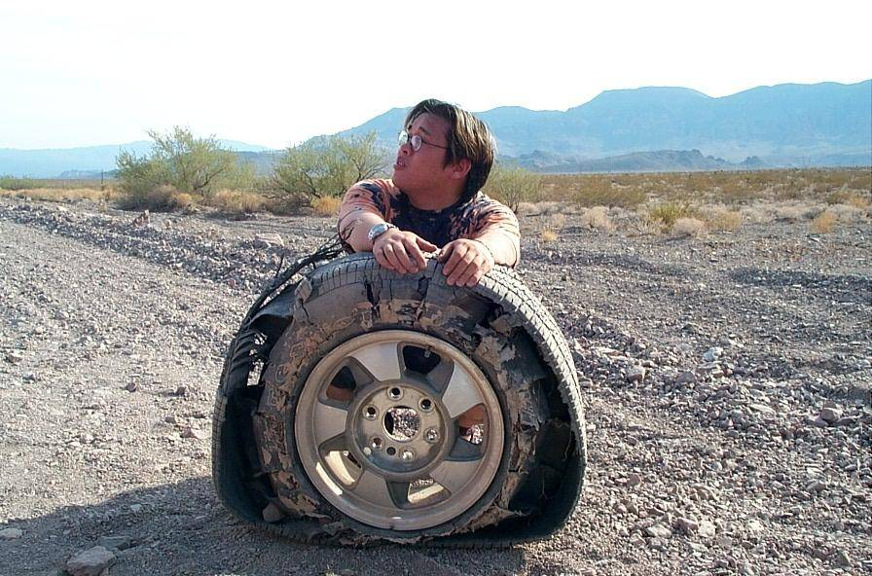
lost...

Slide 49
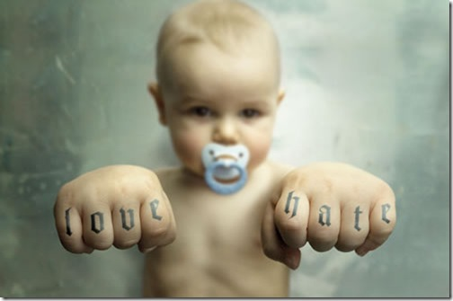

Slide 50
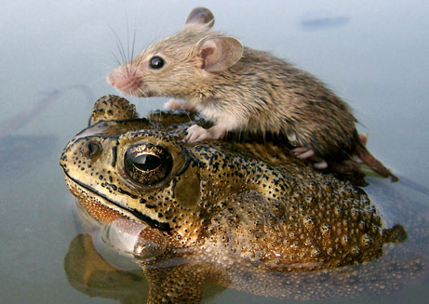

Slide 51
Experiential
Notes:
Connect with people’s experience

Slide 52
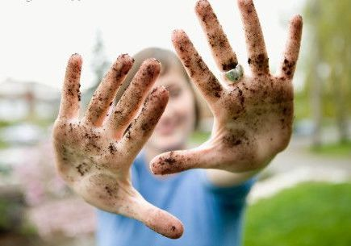
Hands On
Experiential

Slide 53
Risk Taking
Experiential

Slide 54
Engage the Whole
Experiential

Slide 55
black bring them back
Notes:
Use a black slide to bring your audience’s attention back to you and away from staring at the screen

Slide 57
whittle your titles

Slide 58
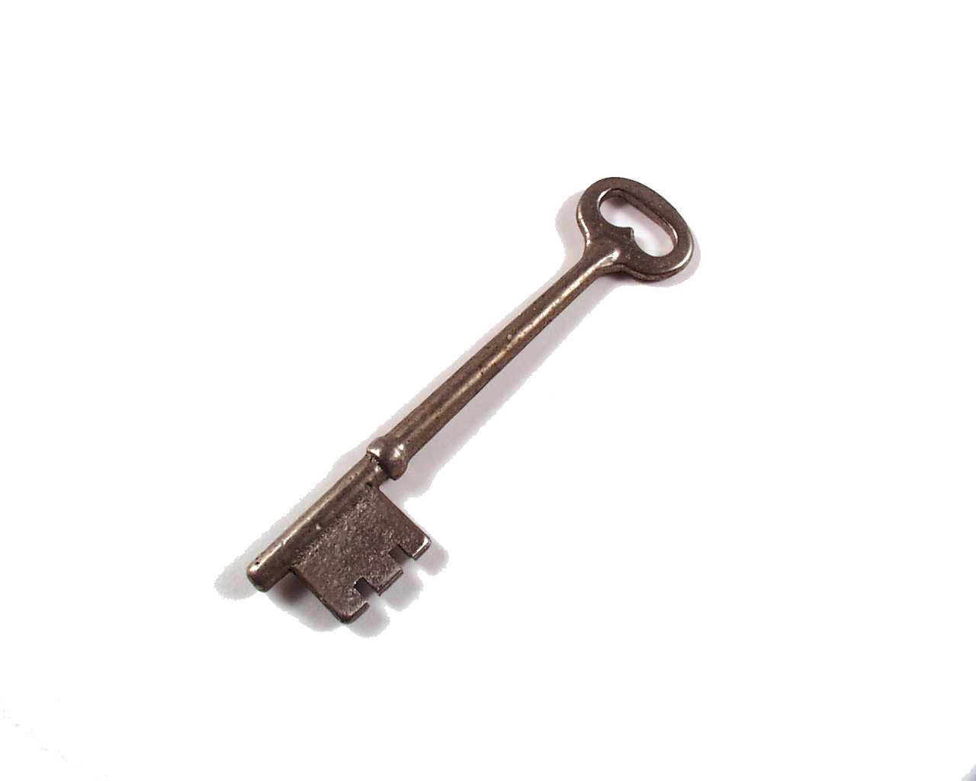
Using peer mentors to drive students towards deep learning and productive reflective writing

Slide 59
Peer mentors improve learning

Slide 60
ditch dot points

Slide 62
Reflection of Learning
Skill 8: Helping learners reflect on what they have learnt

Slide 63
321 RIQ
3 recalls
2 insights
1 question
Notes:
Three things you remember most about today
2 insights worth sharing
1 question you still have

