Slide 1

All the pieces:
the spiritual ecology of Australian students

Slide 2
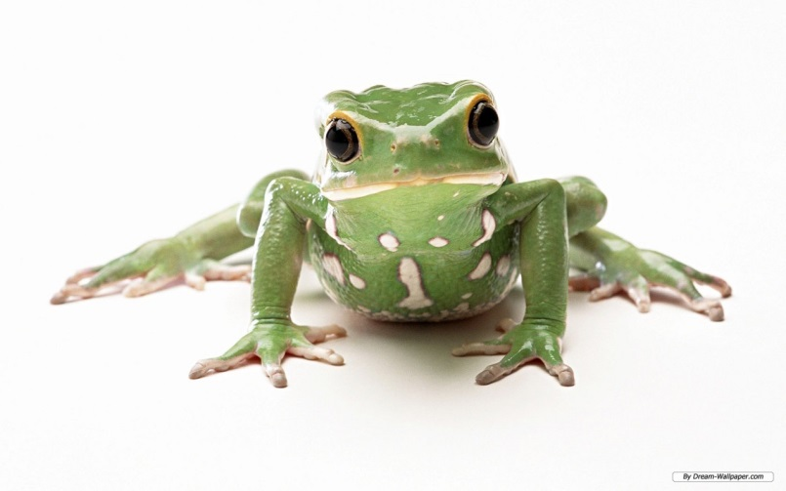
Ecology
the science of interrelationships
between organism
and their environments.

Slide 3
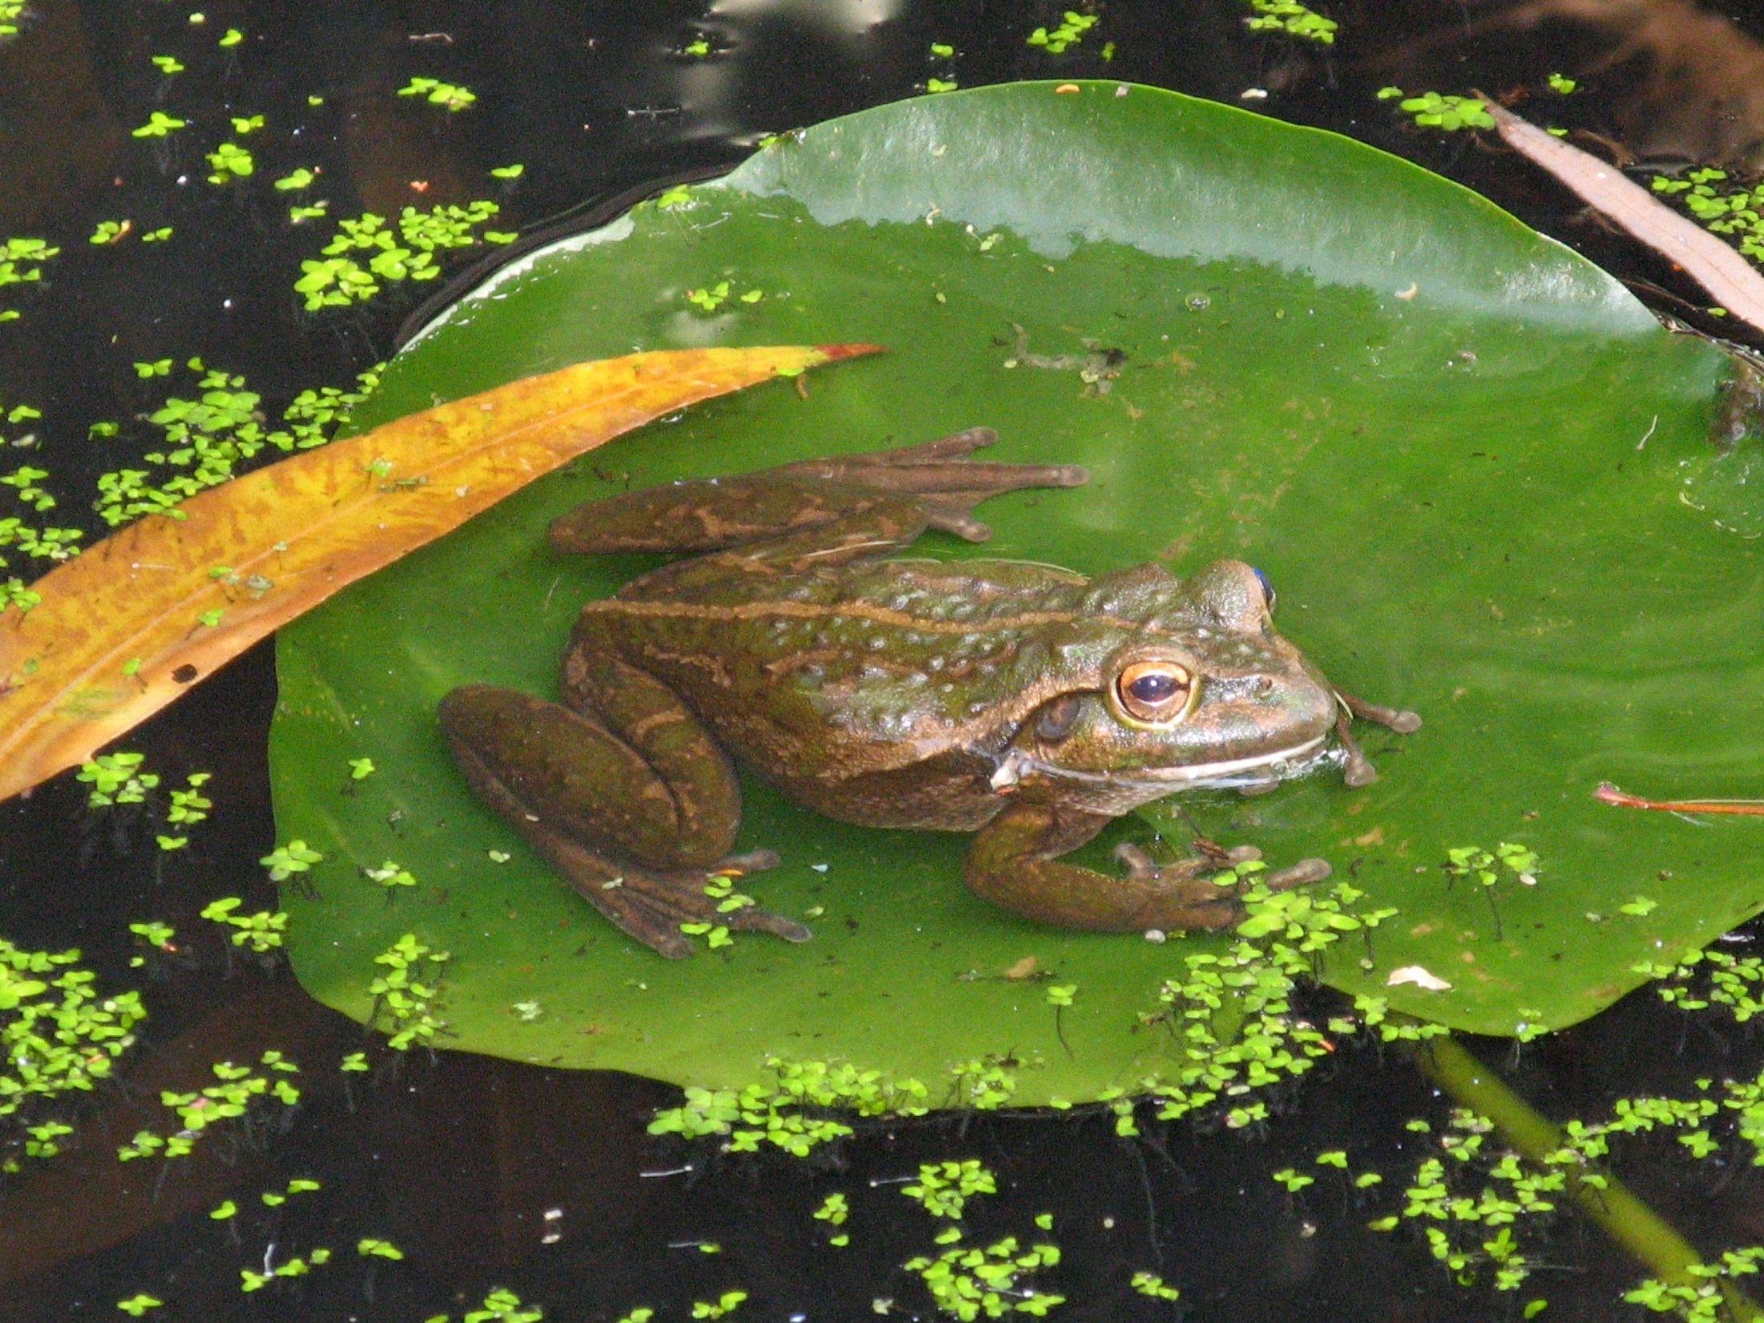

Slide 4
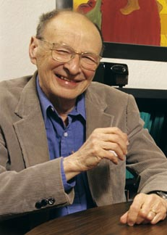
Ecological Systems Theory
Urie Brofenbrenner

Slide 5
Who we are, and the actions that we may take, is largely influenced by our external environment

Slide 6
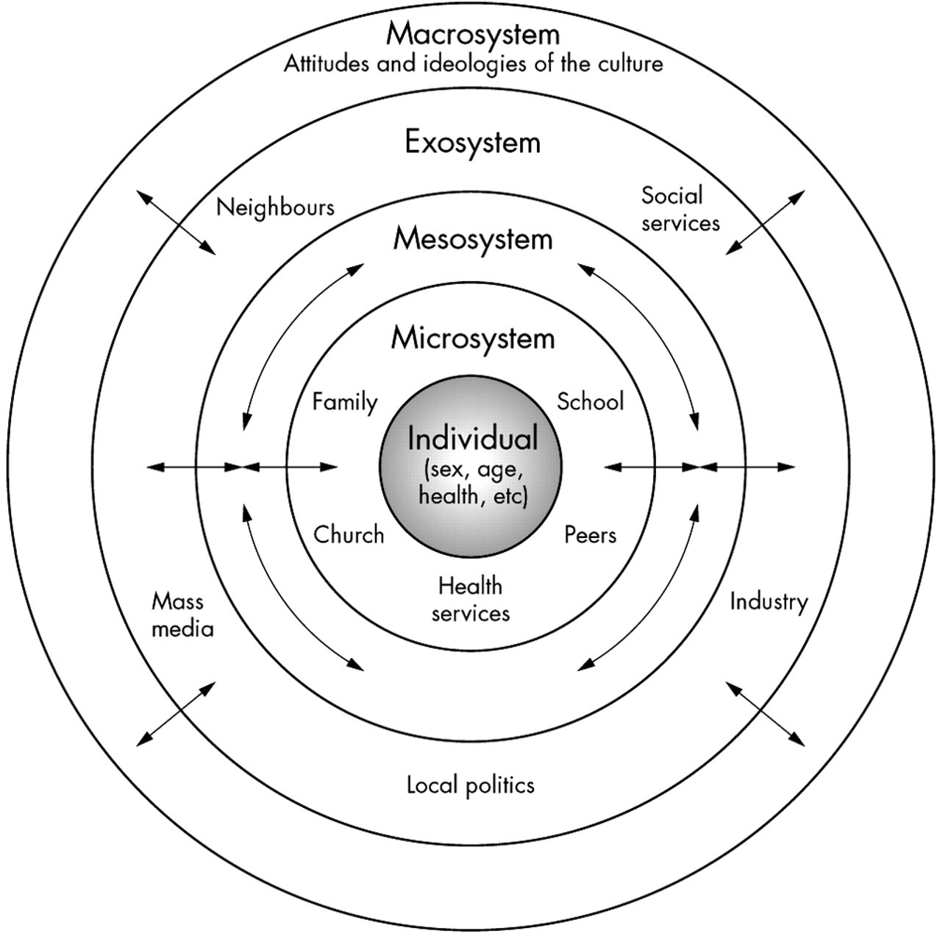

Slide 7
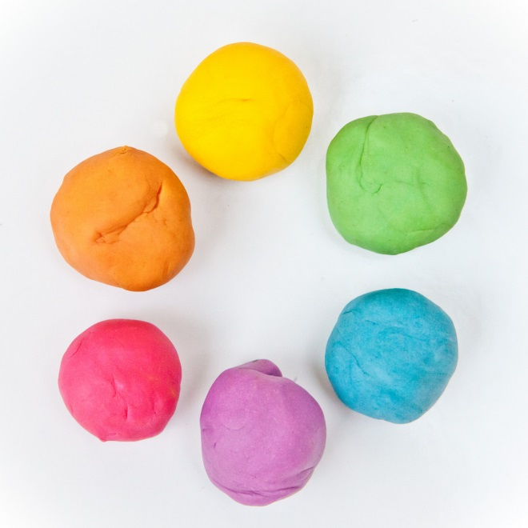

Slide 8

Spiritual Ecology

Slide 9
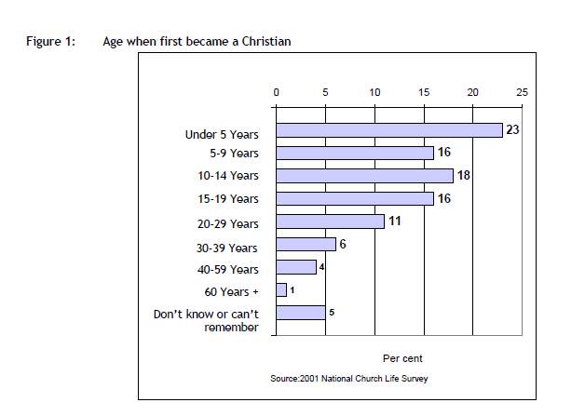

Slide 10

Stats
Over 70% of Anglican & Protestant Believers became Christians before 20.
39% before age 10
34% between 10-19
NCLS Occasional Paper 5 - Social Influences on Faith Devt.

Slide 11
Stats
NCLS Occasional Paper 5 - Social Influences on Faith Devt.

Slide 12
Stats
NCLS Occasional Paper 5 - Social Influences on Faith Devt.

Slide 13

Putting Life Together

Slide 14
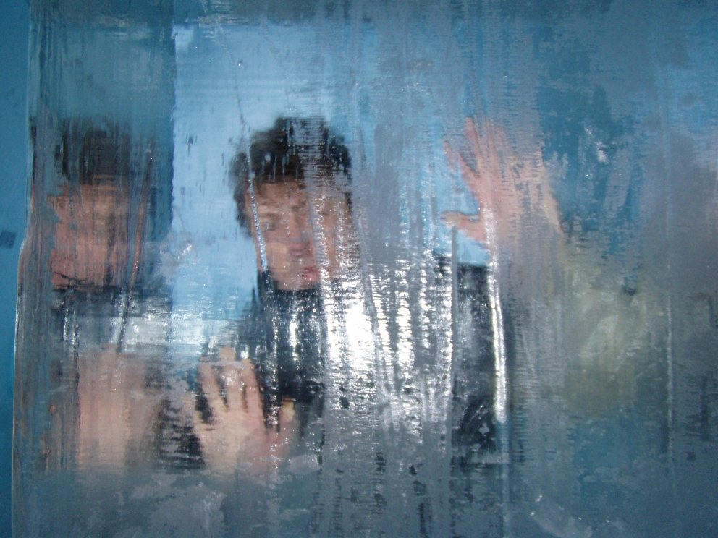
“frozen bloke” effect
Institutional Individualisation

Slide 15

“they should teach that at school” effect
outsourcing reproduction

Slide 16
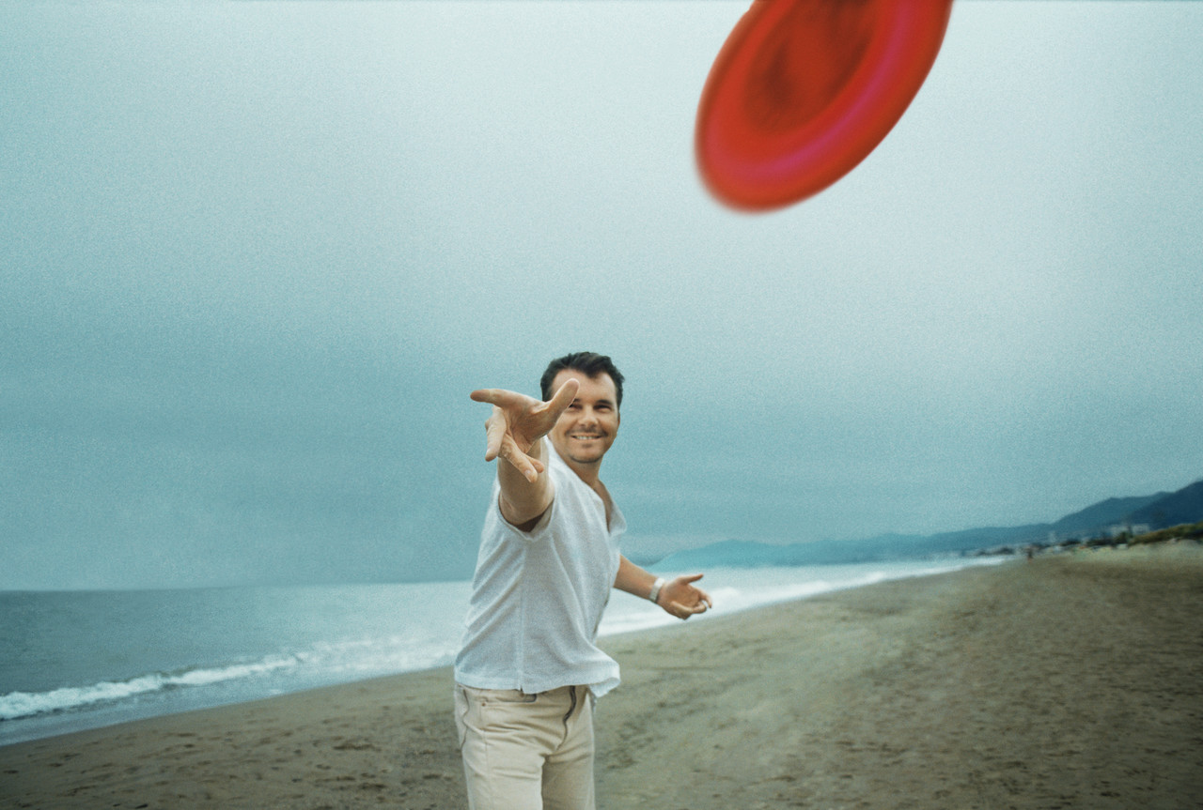
“Friday
five o’clock frisbee” effect
work/family balance

Slide 17


Slide 18
48% of those aged
13-24 have no formal religious belief
Putting Life Together

Slide 19
25% believe in astrology and communication with the dead.
Putting Life Together

Slide 20
31% believe in reincarnation and 21% believe in psychics
Putting Life Together

Slide 21
only 17% seriously follow a religious tradition
Putting Life Together

Slide 22
only 13% are willing to declare that only one religion is true
Putting Life Together

Slide 23
70% my life fits into some sort of great scheme of things
Putting Life Together

Slide 24
93% say life has sense of purpose
Putting Life Together

Slide 25
Putting Life Together

Slide 26
Mission Australia – Queensland Survey of Young Australians

Slide 27
Mission Australia – Queensland Survey of Young Australians

Slide 28
The relative importance of various ways of dealing with the challenges of life?
Prayer
Drugs/Alcohol
Social Networking
Music
Shopping
Nature
Church

Slide 29
The relative importance of various ways of dealing with the challenges of life?
Music (8.1)
Nature (6.4)
Shopping (5.9)
Social Networking (5.6)
Prayer (4.2)
Church (3.9)
Drugs/Alcohol (2.5)

Slide 30
Putting Life Together

Slide 31
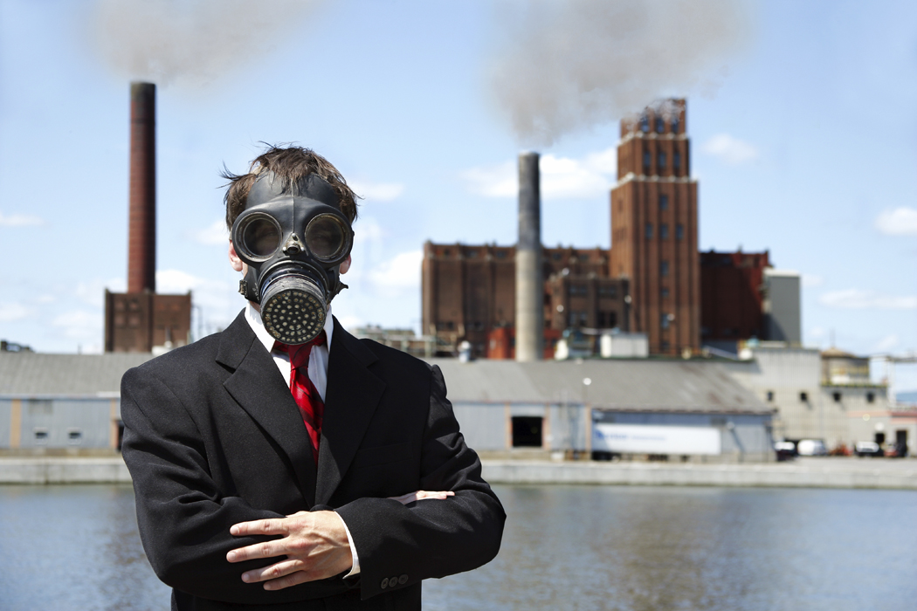
Issues

Slide 32
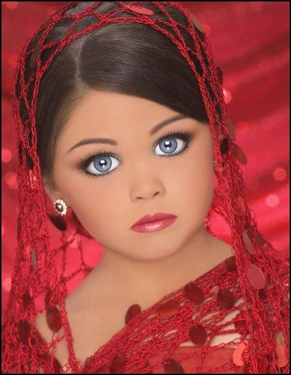
Sexualisation of Society

Slide 33
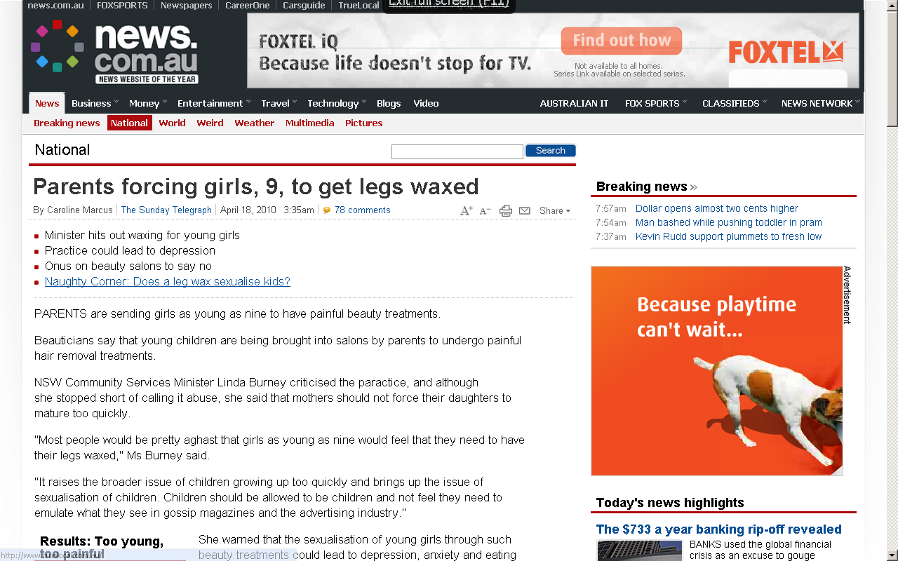

Slide 34
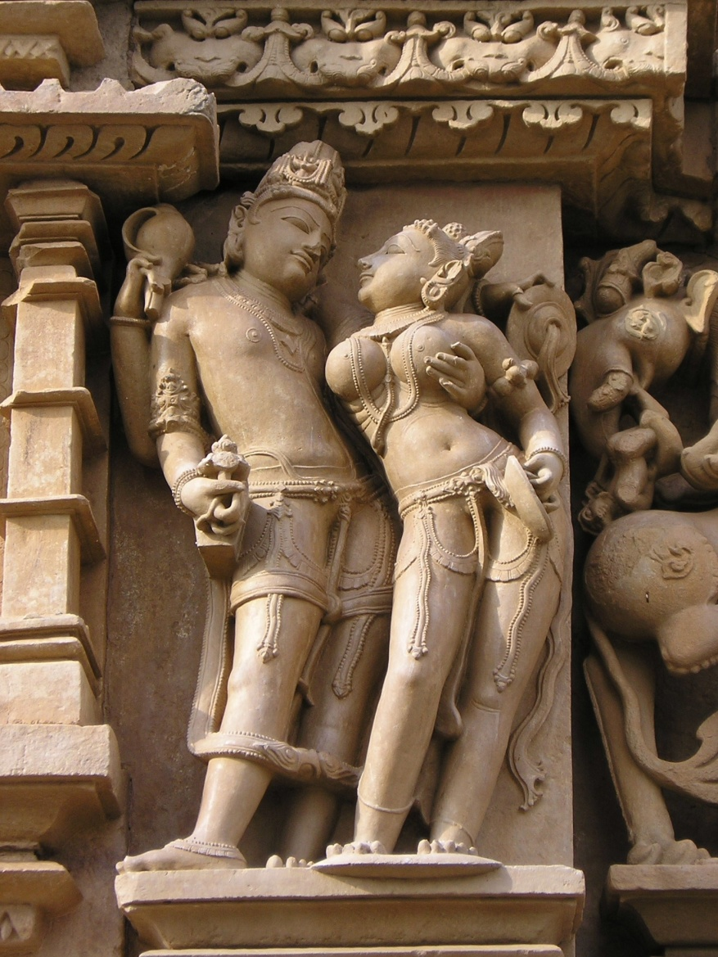
Pornography
censored
censored

Slide 35
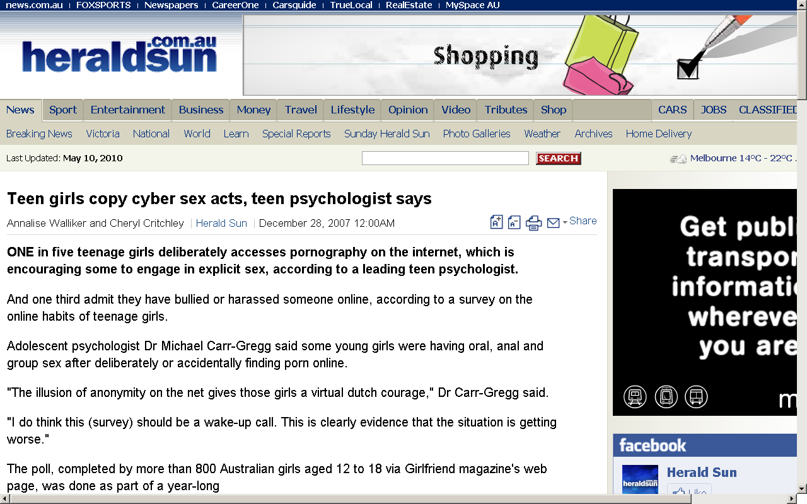

Slide 36
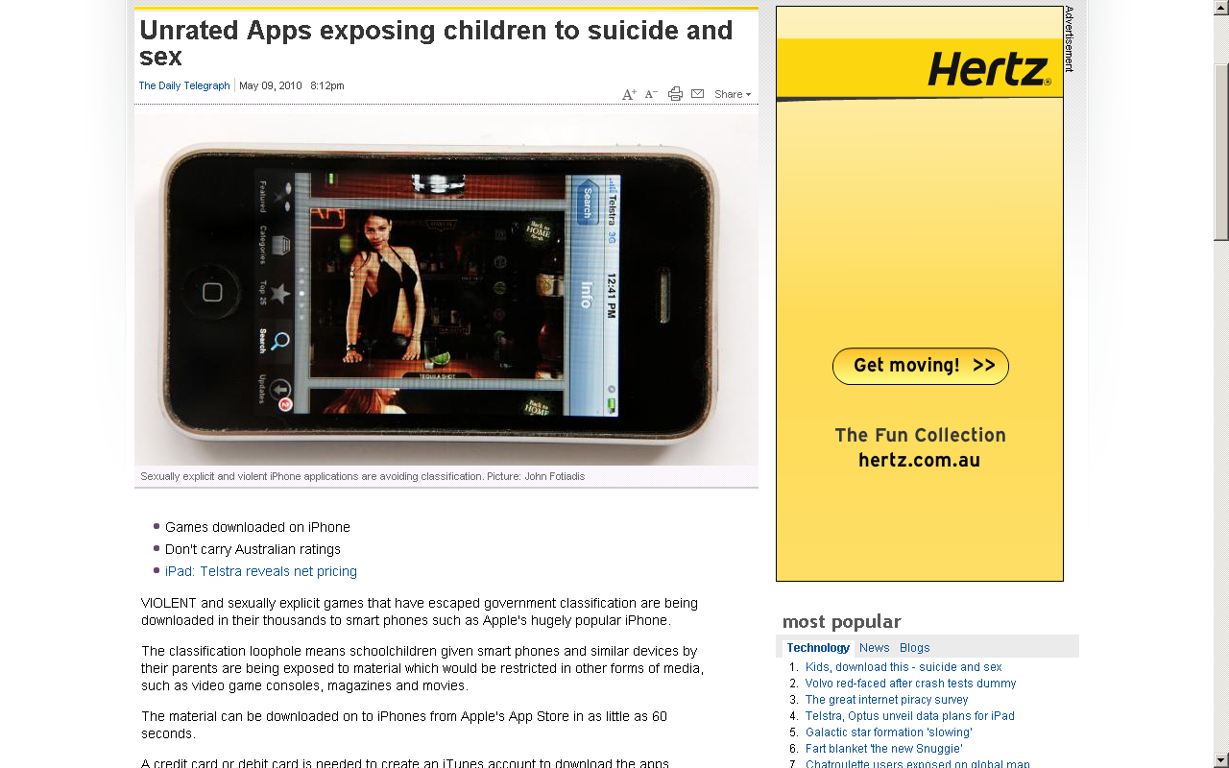

Slide 37

Consumerism

Slide 38
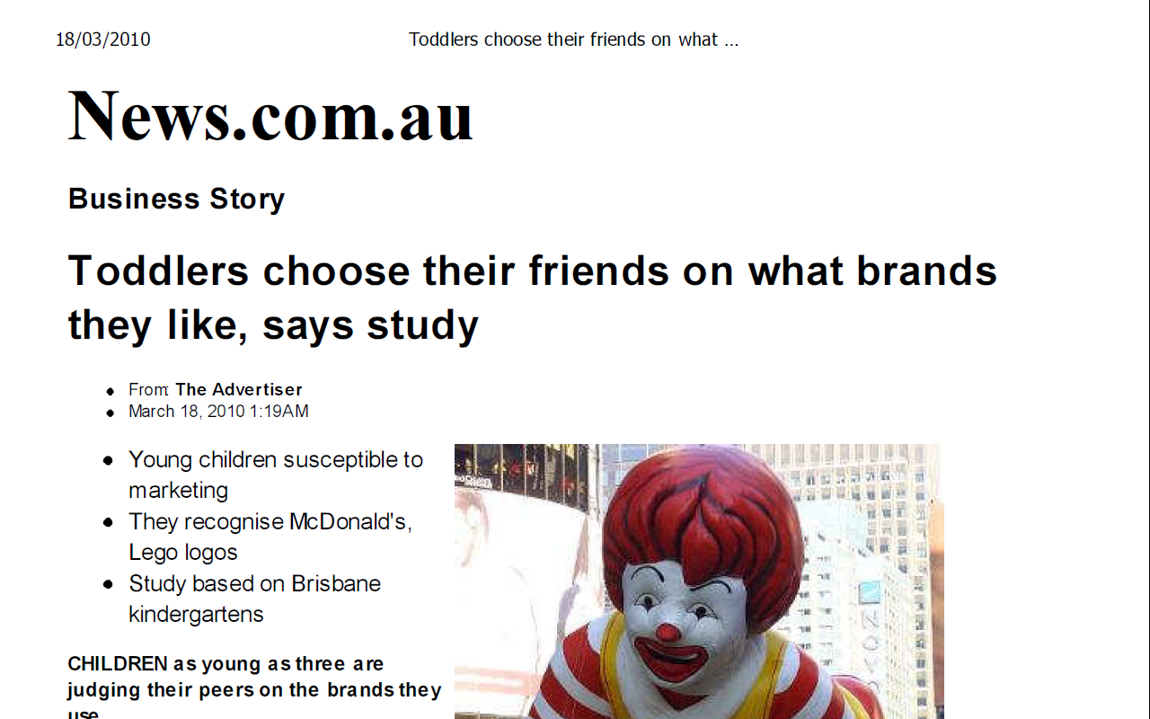

Slide 39
Putting Life Together

Slide 40
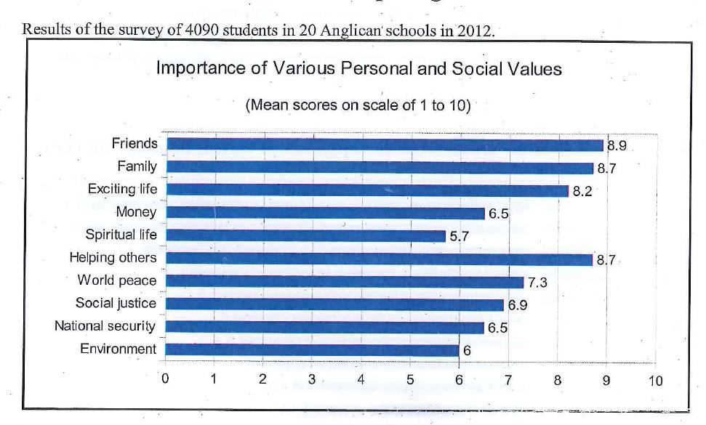

Slide 41
Religious Faith
Among students in Anglican Schools:
    49% see religious education as having little value
    34% as having some values, and
    17% as having high value

Slide 42
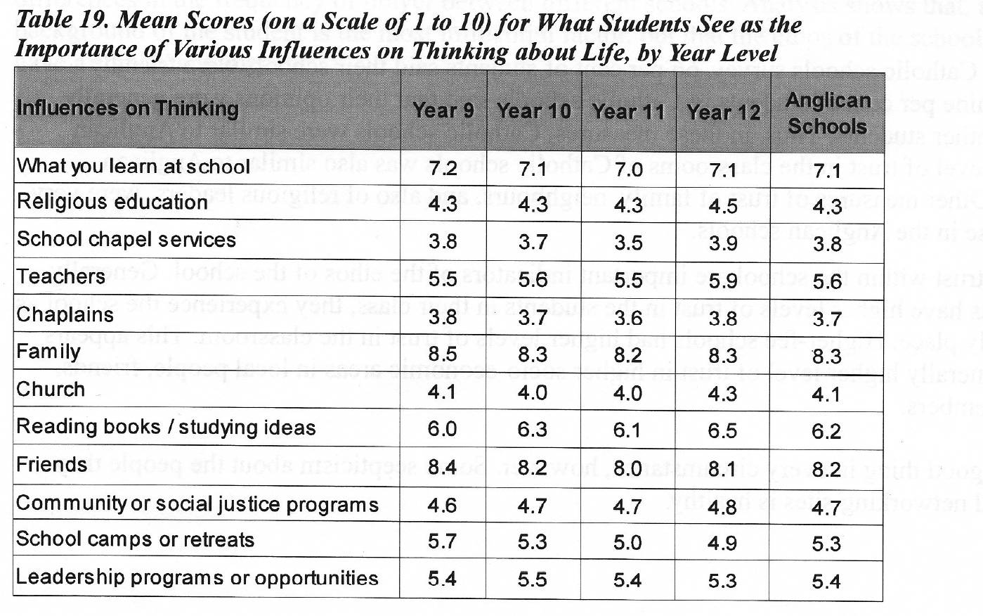

Slide 43
Putting Life Together

Slide 44
Spiritual Ecology

Slide 45

321 RIQ
3 recalls
2 insights
1 questions

Slide 46
All the pieces:
the spiritual ecology of Australian students

