Slide 1
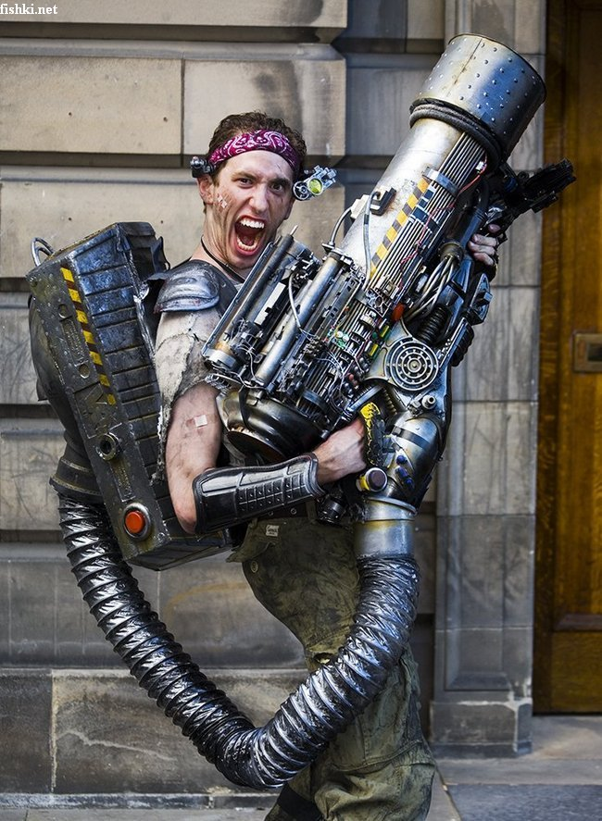
“As Lady Macbeth discovered to her cost, terrible actions weigh on us; they have a price and the debt echoes through our lives. Moral decisions are only truly interesting in a game if their consequences keep coming back. If your player character becomes less efficient with a weapon after every kill, if they become withdrawn, or slower, or fail to level up, how does this change how we play? What if the challenge isn’t just about accuracy or speed with a weapon: what if it becomes, “will there be psychological consequences if I use this weapon?”
Notes:
Ibid
As Lady Macbeth discovered to her cost, terrible actions weigh on us; they have a price and the debt echoes through our lives. Moral decisions are only truly interesting in a game if their consequences keep coming back. If your player character becomes less efficient with a weapon after every kill, if they become withdrawn, or slower, or fail to level up, how does this change how we play? What if the challenge isn’t just about accuracy or speed with a weapon: what if it becomes, “will there be psychological consequences if I use this weapon?”

Slide 2
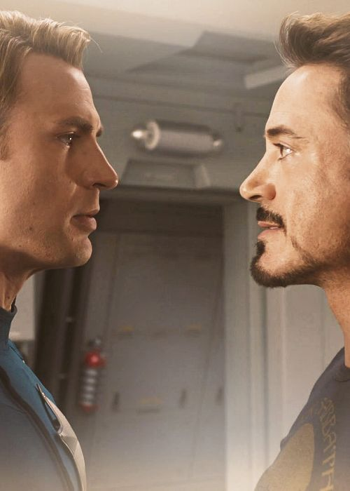
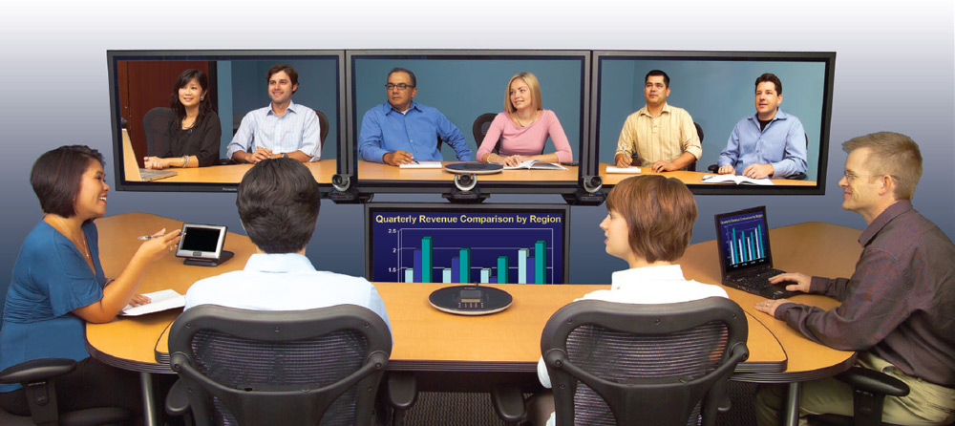
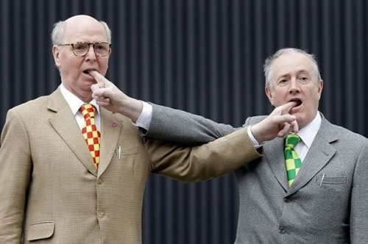
The debate
Community – is face-to-face necessary?
What do you think?
embodiment
Notes:
Theology or embodiment and incarnation might have something to say here…

Slide 3
The debate
Brain reshaping – Neo-plasticity
"As a neuroscientist I am very aware that the brain adapts to its environment - if you're placed in an environment that encourages, say, a short attention span, which doesn't encourage empathy or interpersonal communication, which is partially addictive or compulsive ... all these things will inevitably shape who you are," she said.
"The digital world is an unprecedented one and it could be leaving an unprecedented mark on the brain.“ – Susan Greenfield
http://www.abc.net.au/news/2014-11-20/neuroscientist-warns-young-brains-being-reshaped-by-technology/5906140
http://www.smh.com.au/it-pro/how-digital-culture-is-rewiring-our-brains-20120806-23q5p.html

Slide 4
The debate
Is privacy even a thing anymore?
Responses:
Snapchat
Notes:
Aden’s live tweeting POP Asia – tweets are ‘forever’
Snapchat aimes to circumvent this, or at least markets itself as if it does.

Slide 5
What is Yik Yak?
Like Twitter before it, Yik Yak is a free social media network that allows users to post concise thoughts and observations in real time, and to share them with a wide audience. But unlike other popular social media platforms, Yik Yak is anonymous, with no profile information required or displayed with a users' posts. It's also "local" — curating posts by location — with posts visible within a tight radius. Users can also "peek" at conversation streams happening at particular set locations, such as a college campus.
Notes:
Yik Yak adds the concept of anonymity, hence less accountability

Slide 6
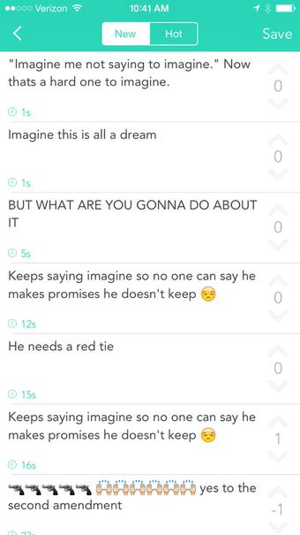
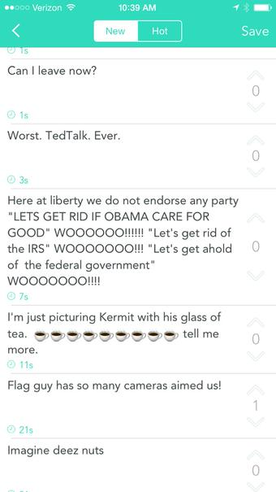
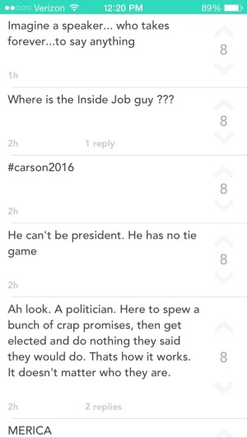
http://www.brisbanetimes.com.au/digital-life/digital-life-news/how-the-yik-yak-app-undermined-republican-ted-cruzs-presidential-campaign-launch-20150323-1m61e1.html

Slide 7
"Yik Yak has the potential, like Twitter, to shape the stories that emerge from any given moment. It's a blank slate that will fill with an emergent consensus," wrote Yahoo's Technology Editor Jason O. Gilbert on Monday.
"As the events get larger, so too will Yik Yak's potential to mould local consensus, identify memes, and generally either elevate or denigrate candidates. And if politicos embraces Yik Yak in the way that the app's young founders imagine, it could end up becoming the candid forum of choice for the 2016 election."
Notes:
Ibid
The context here is political events but the same can be said for any large scale event.

Slide 8
Yik Yak had already been the subject of controversy and media attention in the US due to several high profile cases where the anonymous app was used for bullying of students or teachers, or for making threats. Two schools in California were temporarily closed in the same week in 2014 after seemingly violent threats were made by students using Yik Yak. As a result, the app developers have been placing "geofences" around high schools in the US to stop younger teenagers from using it.

Slide 9
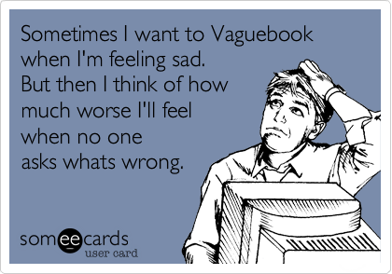
The debate
Is privacy even a thing anymore?
Responses:
Snapchat
Yik Yak
Vaguebooking
Notes:
Vague booking as a way of protecting privacy – “meet you at our fave place”.
But also as an emotional/attention seeking fishing tool.

Slide 10
The debate
The capacity for reflection…
Notes:
Introducing missional possibilities…
Teaching the art of reflection

Slide 11
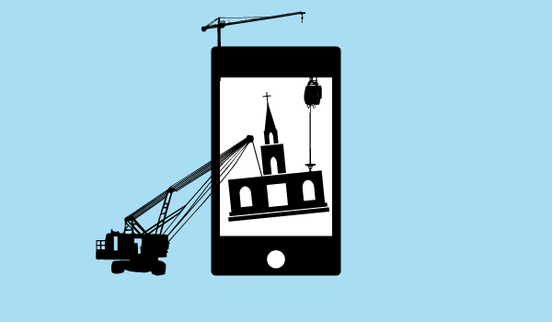
The possibilities – missional responses

Slide 12
St Pauls Arts n Kids
https://www.youtube.com/user/stpaulsartsandmedia
Notes:
An Unexpec – eg of a kids club using technology to tell the storyted Christmas

Slide 13
World Vision - Just Prayers
https://www.worldvision.org.nz/church-resources/just-prayers.aspx
Notes:
The Lords Prayer – enhanced by digital immersion?

Slide 14
Pairing with other ministries in the diocese and beyond
Transforming worship
Screens
Live tweeting
Learning from the lessons of the digital world – Interactivity!

Slide 15
Digital world
Faith world
This is a two way street
As well as having the flexibility to put a screen in the church, we need to be training our members to live out their faith appropriately in their own digital communities.
Soooo...that’s a nice platitude but what does it mean to live out faith appropriately in digital communities?
Notes:
This is not just about introducing digital changes to the church, though we do need that.
Its also about Christians living out their faith in the digital communities.
So how?

Slide 16
http://www.reimaginefaithformation.com/

Slide 17
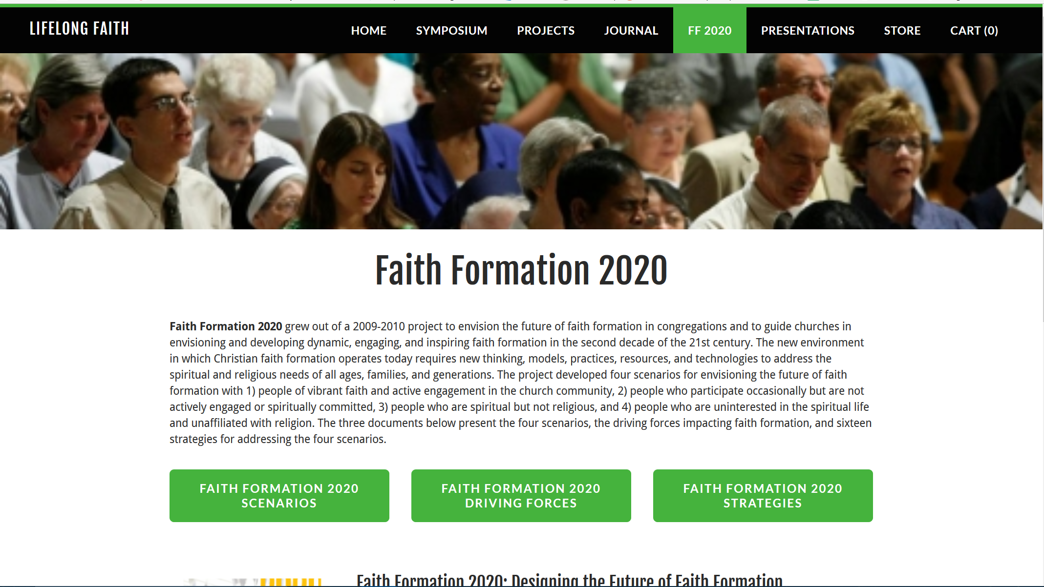
http://www.lifelongfaith.com/ff-2020.html

Slide 18
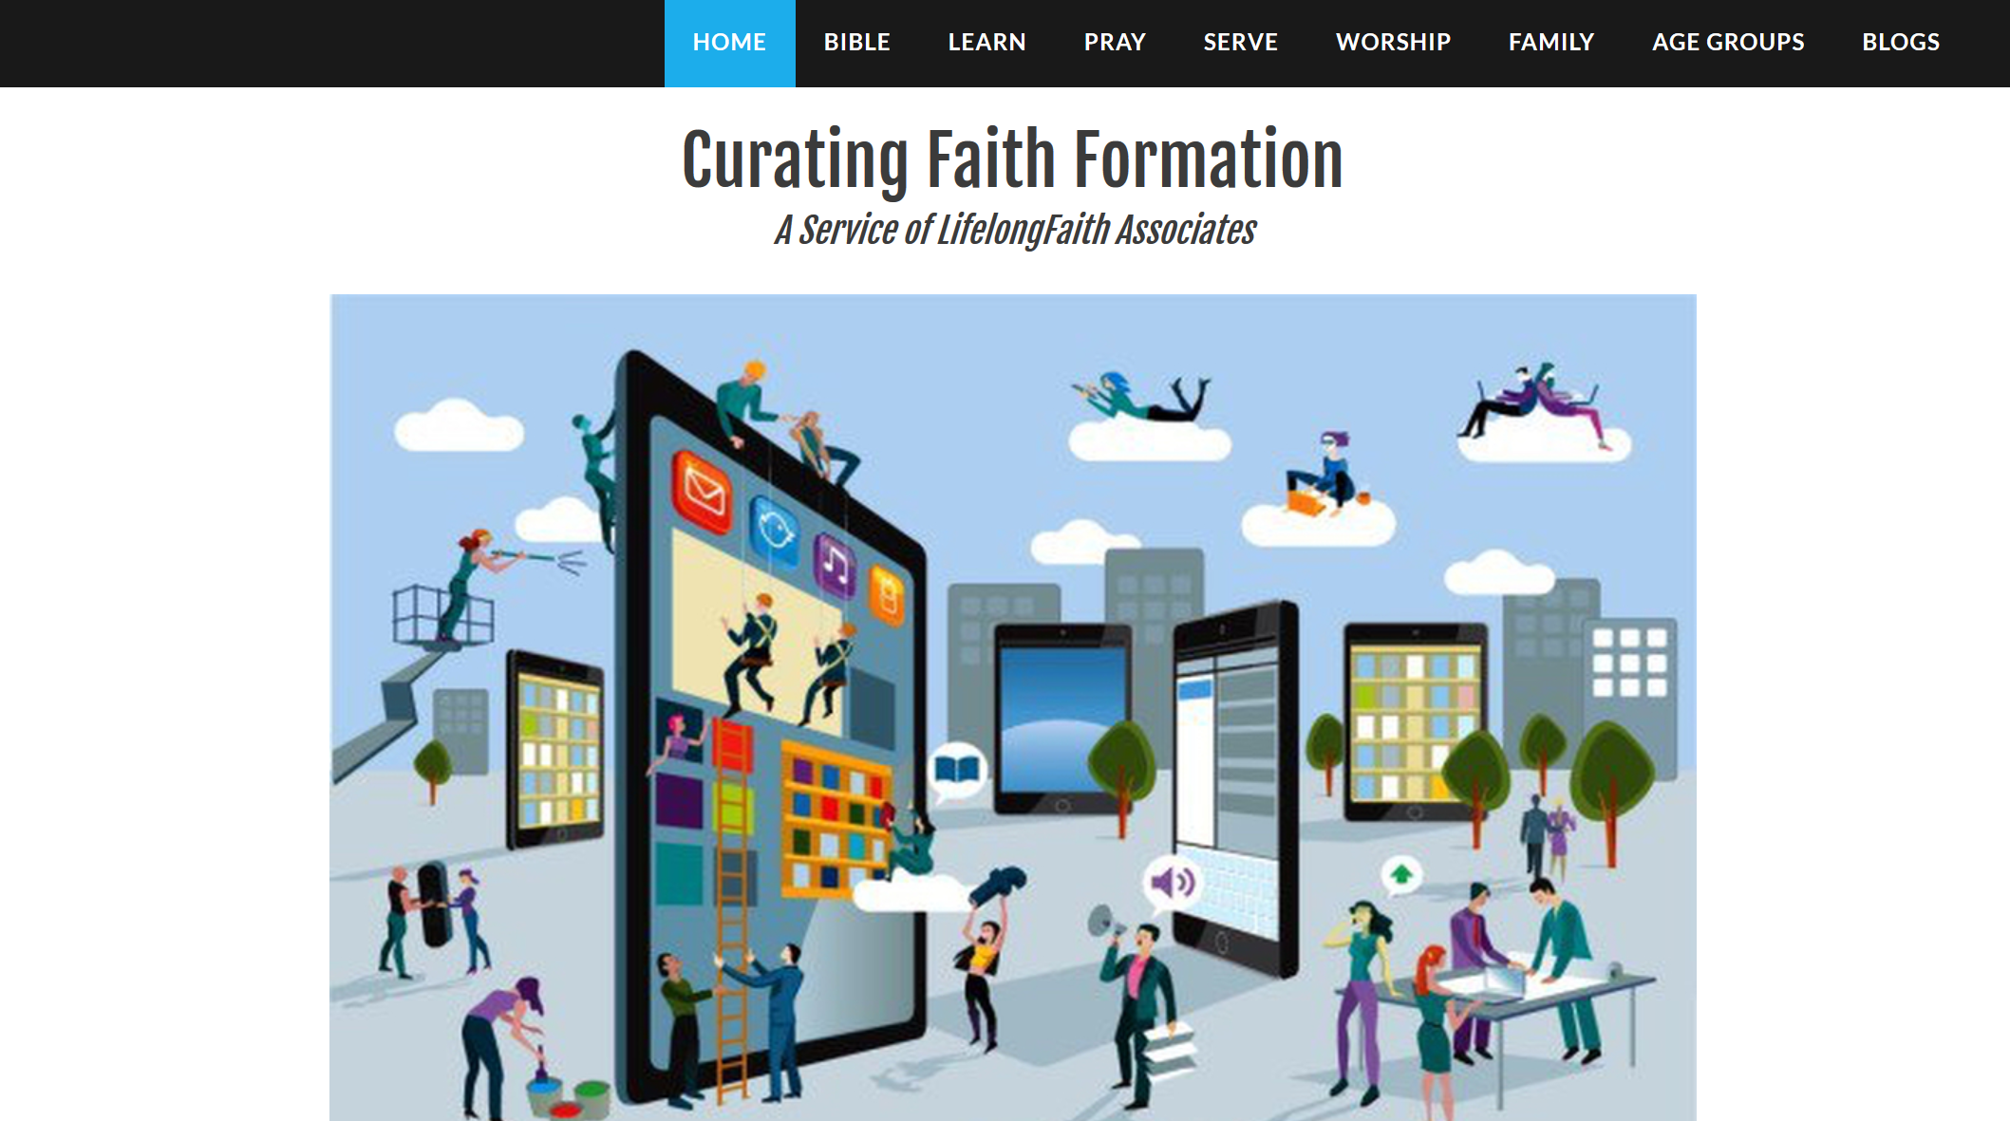
http://www.curatingfaithformation.com/

Slide 19
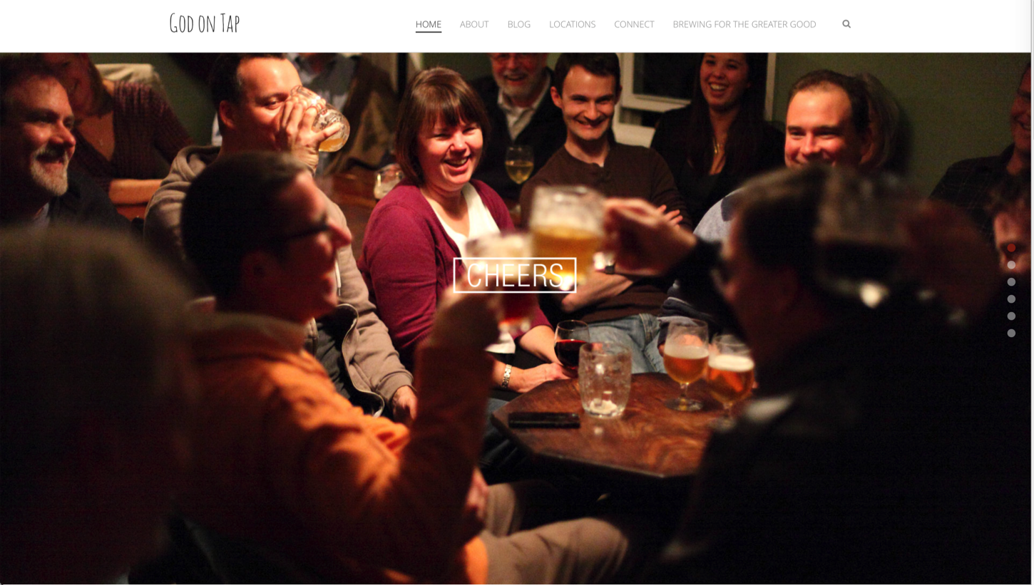

Slide 20
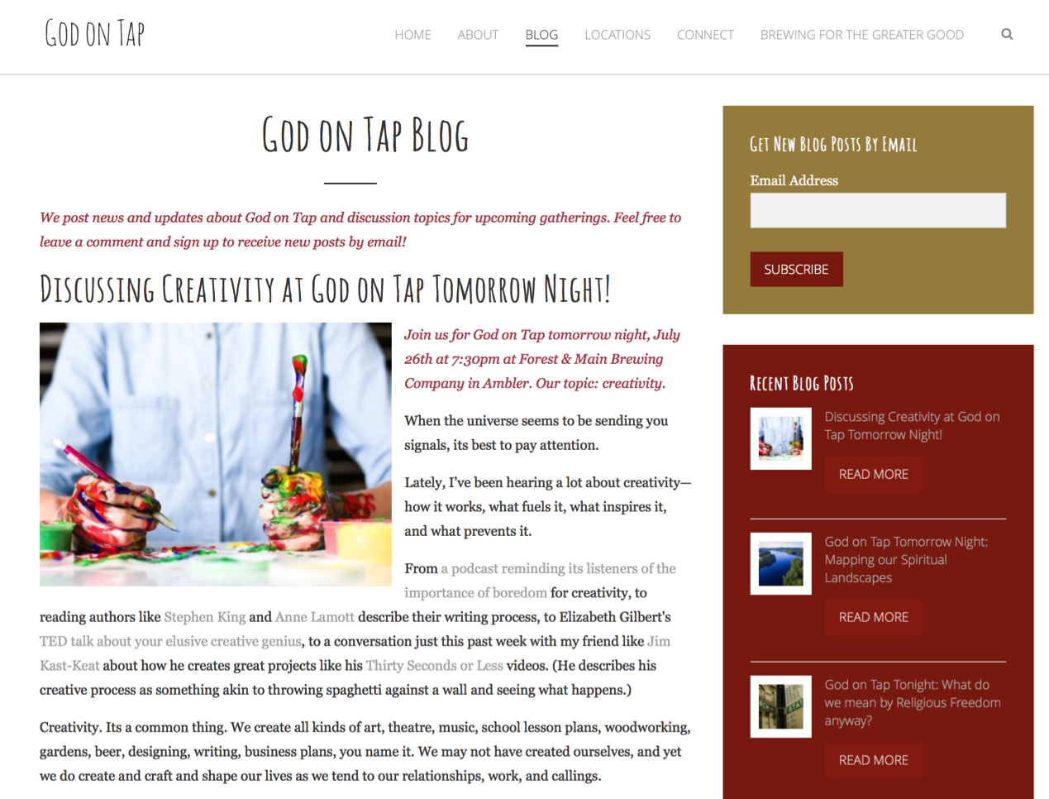

Slide 21
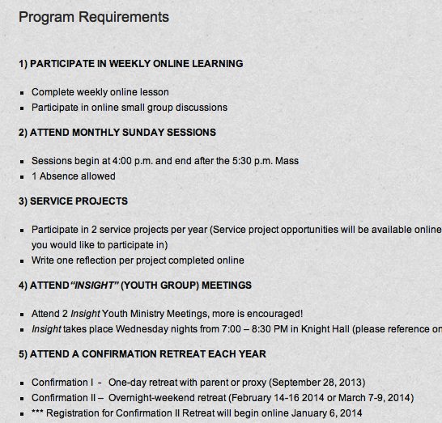
Online and Gathered

Slide 23
Marketing in Four Steps – Seth Godin
The first step is to invent a thing worth making, a story worth telling, a contribution worth talking about.
The second step is to design and build it in a way that people will actually benefit from and care about.
The third one is the one everyone gets all excited about. This is the step where you tell the story to the right people in the right way.
The last step is so often overlooked: The part where you show up, regularly, consistently and generously, for years and years, to organize and lead and build confidence in the change you seek to make.
(http://sethgodin.typepad.com/seths_blog/2016/08/marketing-in-four-steps.html)

Slide 24
The Church and technology
The opportunities
What have you seen?
(answer using these categories..)
New forms of community
New ways to experience God’s presence
New tools to do things we’ve done before

Slide 25
So what would this look like?
...but what does it mean to live out faith appropriately in digital communities?

